Slide 1


A Mega-Analysis of Personality Predictions: Robustness and Boundary Conditions
Emorie D Beck
November 19, 2020
Preprints and/or Slides:
https://psyarxiv.com/7pg9b/
https://github.com/emoriebeck/selection

Slide 2
Selection
Extraversion
Agreeableness
Conscientiousness
Neuroticism
Openness
Move in with Partner (+)
(Specht et al., 2011)
Become Unemployed (+)
(Specht et al., 2011)
Mortality (-)
(Specht et al., 2011)
Mortality (+)
(Specht et al., 2011)
First Job (-)
(Lüdtke et al., 2011)
Have Children (+)
(van Scheppingen et al, 2016)
Separate from Partner (-)
(van Scheppingen et al, 2016)
Health (+)
(van Scheppingen et al, 2016)
Health (-)
(van Scheppingen et al, 2016)
End Relationship (+)
(Lüdtke et al., 2011)
Romantic Relationships (+)
(Wagner et al., 2015)
Do Military Service (-)
Jackson et al., 2012)
Work Experiences (+)
(Lüdtke et al., 2011)
Leave Parents’ Home (+)
(Lüdtke et al., 2011)
Retirement (+)
(Specht et al., 2011)

Slide 3
Selection
Extra-version
Agreeab-leness
Consci-entious-ness
Neurot-icism
Open-ness
Self-Esteem
Optim-ism
Life Satis-faction
Positive Affect
Negat-ive Affect
Locus of Control
Social Support
IQ
Depress-ion
Move in with Partner (+)
(Specht et al., 2011)
Become Unemp-loyed (+)
(Specht et al., 2011)
Mortality (-)
(Specht et al., 2011)
Mortality (+)
(Specht et al., 2011)
First Job (-)
(Lüdtke et al., 2011)
Criminal Behavior (-)
(Trzesniewski et al., 2006)
Heart Problems(-)
(Tindle et al., 2009)
Mortality (-)
(Lyyra et al., 2006)
Inflam-matory markers
(-)
(Specht et al., 2011)
Post-traumatic Stress (+)
(Weems et al., 2007)
Survival after Trans-plant (+)
(Burker et al., 2005)
Mortality (-)
(Brown et al., 2003)
Longevity (+)
(Gottfredson & Deary, 2004)
Heart Failure (+)
(Johnson et al., 2012)
Have Children (+)
(van Scheppingen et al, 2016)
Separate Partner
(-)
(van Scheppingen et al, 2016)
Health (+)
(van Scheppingen et al, 2016)
Health (-)
(van Scheppingen et al, 2016)
End Relation-ship (+)
(Lüdtke et al., 2011)
Smoking (-)
(Trzesniewski et al., 2006)
Marital wellbeing
(+)
(Neff & Geers, 2013)
Divorce
(-)
(Stutzer & Frey, 2006)
Physical Activity (+)
(Audrain et al., 2001)
Common Cold (+)
(Cohen et al., 1993)
Social Mobility (+)
(von Stumm et al, 2009)
Inflam-mation (-)
(Hughes et al., 2014)
Smoking (-)
(Gottfredson, 2004)
Mortality (+)
(Sullivan et al., 2012)
Romantic Relation-ships (+)
(Wagner et al., 2015)
Do Military Service (-)
Jackson et al., 2012)
Work Exper-iences (+)
(Lüdtke et al., 2011)
Leave Parents’ Home (+)
(Lüdtke et al., 2011)
Retire-ment (+)
(Specht et al., 2011)
Heart Problems (-)
(Trzesniewski et al., 2006)
Complet-ing College (-)
(Solberg Ness et al., 2009)
Student Engage-ment(+)
(Heffner & Antaramanian, 2015)
Smoking (-)
(Pettit et al., 2001)
Blood pressure (+)
(Ewart & Kolodner, 1994)
School Achieve-ment (+)
(Tesiny et al., 1980)
Delinq-uency (-)
Kort-Butler, 2010)
Obesity
(-)
(Gottfredson, 2004)
Smoking (+)
(Japuntich et al., 2007)

Slide 4
Limitations of Personality Prediction
Cross-Sectional (Reverse Causality) | Third Variables (Selection Bias) | Arbitrary Covariate Inclusion | Unclear Boundary Conditions | Single Studies
Notes:
Much of the work linking personality to experiences does so cross sectionally, looking at how concurrent measures of personality predict life events experienced up that point (e.g. are you married)

Slide 5
Limitations of Personality Prediction
Cross-Sectional (Reverse Causality) | Third Variables (Selection Bias) | Arbitrary Covariate Inclusion | Unclear Boundary Conditions | Single Studies
Personality
T0
T1
T2
Outcomes
Outcomes
Notes:
Much of the work linking personality to experiences does so cross sectionally, looking at how concurrent measures of personality predict life events experienced up that point (e.g. are you married)

Slide 6
Limitations of Personality Prediction
Cross-Sectional (Reverse Causality) | Third Variables (Selection Bias) | Arbitrary Covariate Inclusion | Unclear Boundary Conditions | Single Studies
Personality
T0
T1
T2
Outcomes
Outcomes
Notes:
Much of the work linking personality to experiences does so cross sectionally, looking at how concurrent measures of personality predict life events experienced up that point (e.g. are you married)

Slide 7
Limitations of Personality Prediction
Cross-Sectional (Reverse Causality) | Third Variables (Selection Bias) | Arbitrary Covariate Inclusion | Unclear Boundary Conditions | Single Studies
Personality
T0
T1
T2
Outcomes
Outcomes
Notes:
Much of the work linking personality to experiences does so cross sectionally, looking at how concurrent measures of personality predict life events experienced up that point (e.g. are you married)

Slide 8
Limitations of Personality Prediction
Cross-Sectional (Reverse Causality) | Third Variables (Selection Bias) | Arbitrary Covariate Inclusion | Unclear Boundary Conditions | Single Studies
Personality
T0
T1
T2
Outcomes
Outcomes
Notes:
Much of the work linking personality to experiences does so cross sectionally, looking at how concurrent measures of personality predict life events experienced up that point (e.g. are you married)

Slide 9
Limitations of Personality Prediction
Cross-Sectional (Reverse Causality) | Third Variables (Selection Bias) | Arbitrary Covariate Inclusion | Unclear Boundary Conditions | Single Studies
Inattention to Third Variables (Selection Bias)
Income
Social
Personality
Age
Early Life
Health
Education
Family
T0
T1
T2
Outcomes
Outcomes
Notes:
Much of the work linking personality to experiences does so cross sectionally, looking at how concurrent measures of personality predict life events experienced up that point (e.g. are you married)

Slide 10
Limitations of Personality Prediction
Cross-Sectional (Reverse Causality) | Third Variables (Selection Bias) | Arbitrary Covariate Inclusion | Unclear Boundary Conditions | Single Studies
Income
Social
Personality
Age
Early Life
Health
Education
Family
T0
T1
T2
Outcomes
Outcomes
Notes:
Much of the work linking personality to experiences does so cross sectionally, looking at how concurrent measures of personality predict life events experienced up that point (e.g. are you married)

Slide 11
Limitations of Personality Prediction
Cross-Sectional (Reverse Causality) | Third Variables (Selection Bias) | Arbitrary Covariate Inclusion | Unclear Boundary Conditions | Single Studies
Income
Social
Personality
Age
Early Life
Health
Education
Family
T0
T1
T2
Outcomes
Outcomes
Notes:
Much of the work linking personality to experiences does so cross sectionally, looking at how concurrent measures of personality predict life events experienced up that point (e.g. are you married)

Slide 12
Limitations of Personality Prediction
Cross-Sectional (Reverse Causality) | Third Variables (Selection Bias) | Arbitrary Covariate Inclusion | Unclear Boundary Conditions | Single Studies
Income
Social
Personality
Age
Early Life
Health
Education
Family
T0
T1
T2
Outcomes
Outcomes
Notes:
Much of the work linking personality to experiences does so cross sectionally, looking at how concurrent measures of personality predict life events experienced up that point (e.g. are you married)

Slide 13
Limitations of Personality Prediction
Cross-Sectional (Reverse Causality) | Third Variables (Selection Bias) | Arbitrary Covariate Inclusion | Unclear Boundary Conditions | Single Studies
Income
Social
Personality
Age
Early Life
Health
Education
Family
T0
T1
T2
Outcomes
Outcomes
Notes:
Much of the work linking personality to experiences does so cross sectionally, looking at how concurrent measures of personality predict life events experienced up that point (e.g. are you married)

Slide 14
Limitations of Personality Prediction
Cross-Sectional (Reverse Causality) | Third Variables (Selection Bias) | Arbitrary Covariate Inclusion | Unclear Boundary Conditions | Single Studies
Income
Social
Personality
Age
Early Life
Health
Education
Family
T0
T1
T2
Outcomes
Outcomes
Notes:
Much of the work linking personality to experiences does so cross sectionally, looking at how concurrent measures of personality predict life events experienced up that point (e.g. are you married)

Slide 15
Limitations of Personality Prediction
Cross-Sectional (Reverse Causality) | Third Variables (Selection Bias) | Arbitrary Covariate Inclusion | Unclear Boundary Conditions | Single Studies
Personality
Age
✓
T0
T1
T2
Outcomes
Outcomes
Notes:
Much of the work linking personality to experiences does so cross sectionally, looking at how concurrent measures of personality predict life events experienced up that point (e.g. are you married)

Slide 16
Limitations of Personality Prediction
Cross-Sectional (Reverse Causality) | Third Variables (Selection Bias) | Arbitrary Covariate Inclusion | Unclear Boundary Conditions | Single Studies
Personality
Age
Health
×
T0
T1
T2
Outcomes
Outcomes
Notes:
Much of the work linking personality to experiences does so cross sectionally, looking at how concurrent measures of personality predict life events experienced up that point (e.g. are you married)

Slide 17
Limitations of Personality Prediction
Cross-Sectional (Reverse Causality) | Third Variables (Selection Bias) | Arbitrary Covariate Inclusion | Unclear Boundary Conditions | Single Studies
Personality
T0
T1
T2
Outcomes
Outcomes

Slide 18


Limitations of Personality Prediction
Cross-Sectional (Reverse Causality) | Third Variables (Selection Bias) | Arbitrary Covariate Inclusion | Unclear Boundary Conditions | Single Studies
T0
T1
T2

Slide 19
Limitations of Personality Prediction
Cross-Sectional (Reverse Causality) | Third Variables (Selection Bias) | Arbitrary Covariate Inclusion | Unclear Boundary Conditions | Single Studies
T0
T1
T2
T0
T1
T2
T0
T1
T2
T0
T1
T2
T0
T1
T2
T0
T1
T2

Slide 20
Limitations of Personality Prediction
Cross-Sectional (Reverse Causality) | Third Variables (Selection Bias) | Arbitrary Covariate Inclusion | Unclear Boundary Conditions | Single Studies
×
T0
T1
T2
×
T0
T1
T2
✓
T0
T1
T2
✓
T0
T1
T2
✓
T0
T1
T2
×
T0
T1
T2

Slide 21
Limitations of Personality Prediction
Problem | Longitudinal Design | Propensity Score Matching | Specification Curve Analysis | Mega-Analysis
Cross-Sectional (Reverse Causality) | ✓ | ✓
Third Variables (Selection Bias) | ✓ | ✓ | ✓
Arbitrary Covariate Inclusion |  | ✓ | ✓
Unclear Boundary Conditions |  | ✓ | ✓ | ✓
Single Studies |  |  |  | ✓

Slide 22
Limitations of Personality Prediction
Problem | Longitudinal Design | Propensity Score Matching | Specification Curve Analysis | Mega-Analysis
Cross-Sectional (Reverse Causality) | ✓ | ✓
Third Variables (Selection Bias) | ✓ | ✓ | ✓
Arbitrary Covariate Inclusion |  | ✓ | ✓
Unclear Boundary Conditions |  | ✓ | ✓ | ✓
Single Studies |  |  |  | ✓

Slide 23
The Current Study
How robust are personality-outcome associations…
Longitudinally?
Across studies?
Controlling for selection bias?
Across moderators?
Across covariates?
Preregistration: https://osf.io/tcysh

Slide 24
14 Predictors | 14 Outcomes | 8 Moderators | 10 Studies
Extraversion | Mortality | Age | Add Health
Agreeableness | Major Health Event | Gender | BHPS (and US)
Conscientiousness | Mental Health Event | Race | GSOEP
Neuroticism | Childbirth | Parental Education (SES) | HILDA
Openness to Experience | Move in with a Partner | Par. Occ. Prestige (SES) | HRS
Self-Esteem | Marriage | Gross Wages (SES) | LISS
Optimism / Pessimism | Divorce | Reliability | MIDUS
Satisfaction with Life | Child Moves Out | Prediction Interval | NLSY
Positive Affect | Higher Education |  | SHP
Negative Affect | First Job | 2 Methods | WLS (G&S)
Locus of Control | Unemployment | Propensity Score Matching
Social Support | Retirement | Specification Curve Analysis
IQ | Volunteering
Depression | Criminal Behavior
Health
Social
Work/Edu
Civic
Notes:
NOT GOING TO SPEND TIME GOING OVER MEASURES IN DETAIL HERE BUT HAPPY TO ANSWER QUESTIONS ABOUT IT

Slide 25
14 Predictors | 14 Outcomes | 8 Moderators | 10 Studies
Extraversion | Mortality | Age | Add Health
Agreeableness | Major Health Event | Gender | BHPS (and US)
Conscientiousness | Mental Health Event | Race | GSOEP
Neuroticism | Childbirth | Parental Education (SES) | HILDA
Openness to Experience | Move in with a Partner | Par. Occ. Prestige (SES) | HRS
Self-Esteem | Marriage | Gross Wages (SES) | LISS
Optimism / Pessimism | Divorce | Reliability | MIDUS
Satisfaction with Life | Child Moves Out | Prediction Interval | NLSY
Positive Affect | Higher Education |  | SHP
Negative Affect | First Job | 2 Methods | WLS (G&S)
Locus of Control | Unemployment | Propensity Score Matching
Social Support | Retirement | Specification Curve Analysis
IQ / Cognitive Ability | Volunteering
Depression | Criminal Behavior
Health
Social
Work/Edu
Civic

Slide 26
14 Predictors | 14 Outcomes | 8 Moderators | 10 Studies
Extraversion | Mortality | Age | Add Health
Agreeableness | Major Health Event | Gender | BHPS (and US)
Conscientiousness | Mental Health Event | Race | GSOEP
Neuroticism | Childbirth | Parental Education (SES) | HILDA
Openness to Experience | Move in with a Partner | Par. Occ. Prestige (SES) | HRS
Self-Esteem | Marriage | Gross Wages (SES) | LISS
Optimism / Pessimism | Divorce | Reliability | MIDUS
Satisfaction with Life | Child Moves Out | Prediction Interval | NLSY
Positive Affect | Higher Education |  | SHP
Negative Affect | First Job | 2 Methods | WLS (G&S)
Locus of Control | Unemployment | Propensity Score Matching
Social Support | Retirement | Specification Curve Analysis
IQ / Cognitive Ability | Volunteering
Depression | Criminal Behavior
Health
Social
Work/Edu
Civic

Slide 27
14 Predictors | 14 Outcomes | 8 Moderators | 10 Studies
Extraversion | Mortality | Age | Add Health
Agreeableness | Major Health Event | Gender | BHPS (and US)
Conscientiousness | Mental Health Event | Race | GSOEP
Neuroticism | Childbirth | Parental Education (SES) | HILDA
Openness to Experience | Move in with a Partner | Par. Occ. Prestige (SES) | HRS
Self-Esteem | Marriage | Gross Wages (SES) | LISS
Optimism / Pessimism | Divorce | Reliability | MIDUS
Satisfaction with Life | Child Moves Out | Prediction Interval | NLSY
Positive Affect | Higher Education |  | SHP
Negative Affect | First Job | 2 Methods | WLS (G&S)
Locus of Control | Unemployment | Propensity Score Matching
Social Support | Retirement | Specification Curve Analysis
IQ / Cognitive Ability | Volunteering
Depression | Criminal Behavior
Health
Social
Work/Edu
Civic

Slide 28
14 Predictors | 14 Outcomes | 8 Moderators | 10 Studies
Extraversion | Mortality | Age | Add Health
Agreeableness | Major Health Event | Gender | BHPS (and US)
Conscientiousness | Mental Health Event | Race | GSOEP
Neuroticism | Childbirth | Parental Education (SES) | HILDA
Openness to Experience | Move in with a Partner | Par. Occ. Prestige (SES) | HRS
Self-Esteem | Marriage | Gross Wages (SES) | LISS
Optimism / Pessimism | Divorce | Reliability | MIDUS
Satisfaction with Life | Child Moves Out | Prediction Interval | NLSY
Positive Affect | Higher Education |  | SHP
Negative Affect | First Job | 2 Methods | WLS (G&S)
Locus of Control | Unemployment | Propensity Score Matching
Social Support | Retirement | Specification Curve Analysis
IQ / Cognitive Ability | Volunteering
Depression | Criminal Behavior
Health
Social
Work/Edu
Civic

Slide 29
14 Predictors | 14 Outcomes | 8 Moderators | 10 Studies
Extraversion | Mortality | Age | Add Health
Agreeableness | Major Health Event | Gender | BHPS (and US)
Conscientiousness | Mental Health Event | Race | GSOEP
Neuroticism | Childbirth | Parental Education (SES) | HILDA
Openness to Experience | Move in with a Partner | Par. Occ. Prestige (SES) | HRS
Self-Esteem | Marriage | Gross Wages (SES) | LISS
Optimism / Pessimism | Divorce | Reliability | MIDUS
Satisfaction with Life | Child Moves Out | Prediction Interval | NLSY
Positive Affect | Higher Education |  | SHP
Negative Affect | First Job | 2 Methods | WLS (G&S)
Locus of Control | Unemployment | Propensity Score Matching
Social Support | Retirement | Specification Curve Analysis
IQ / Cognitive Ability | Volunteering
Depression | Criminal Behavior
Health
Social
Work/Edu
Civic

Slide 30
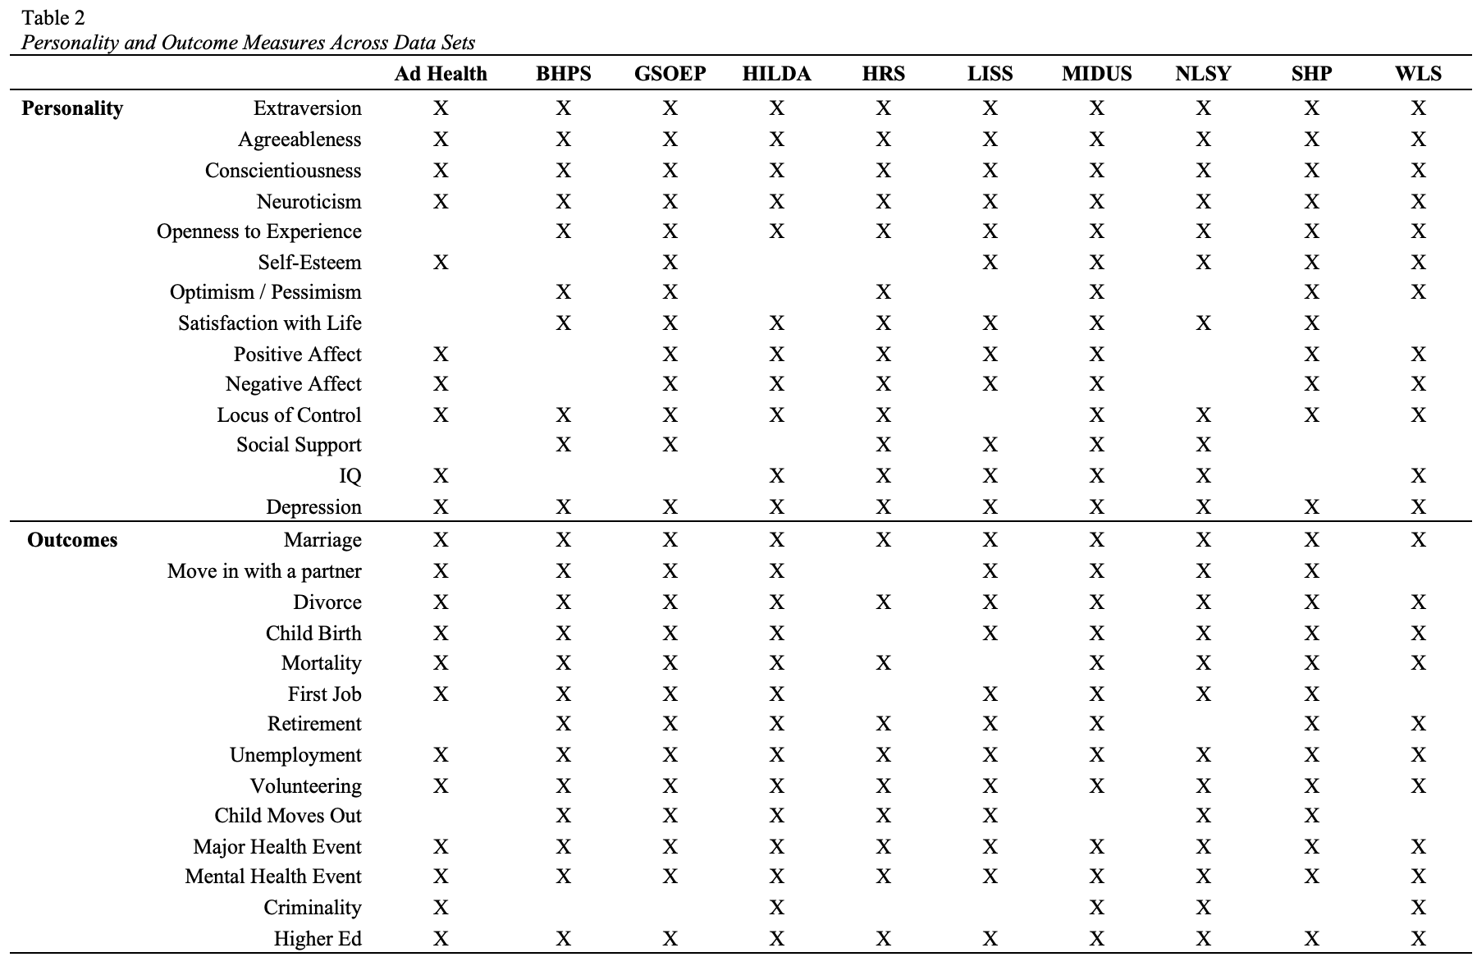

Slide 32
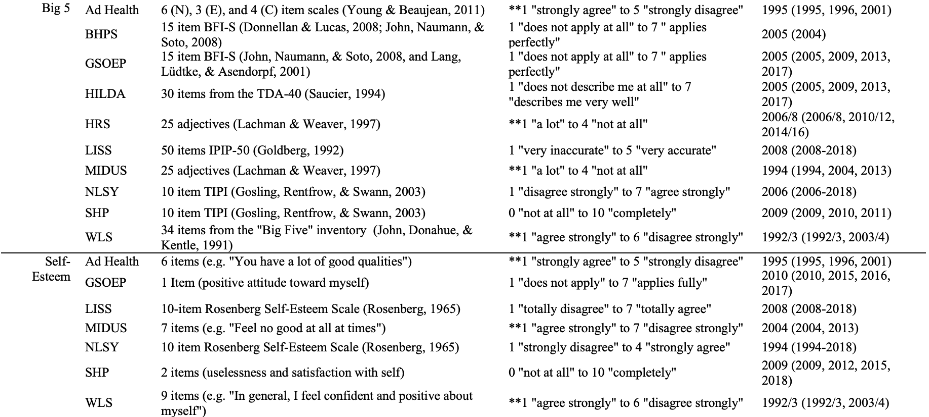

Slide 33
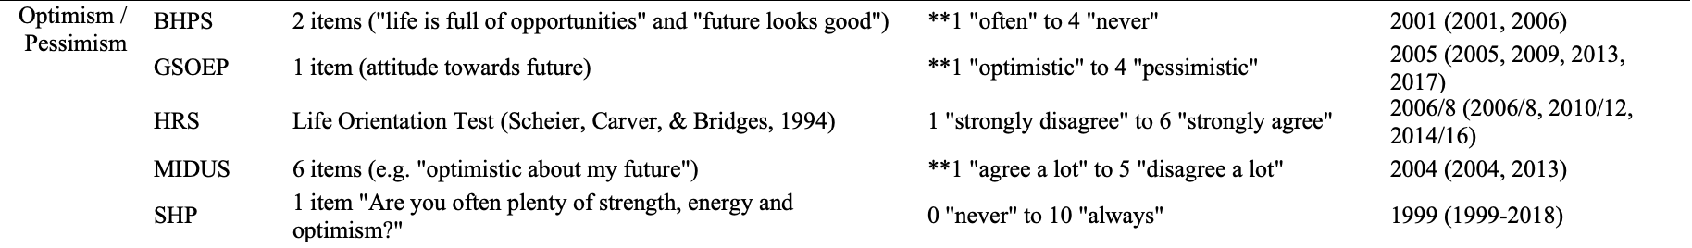
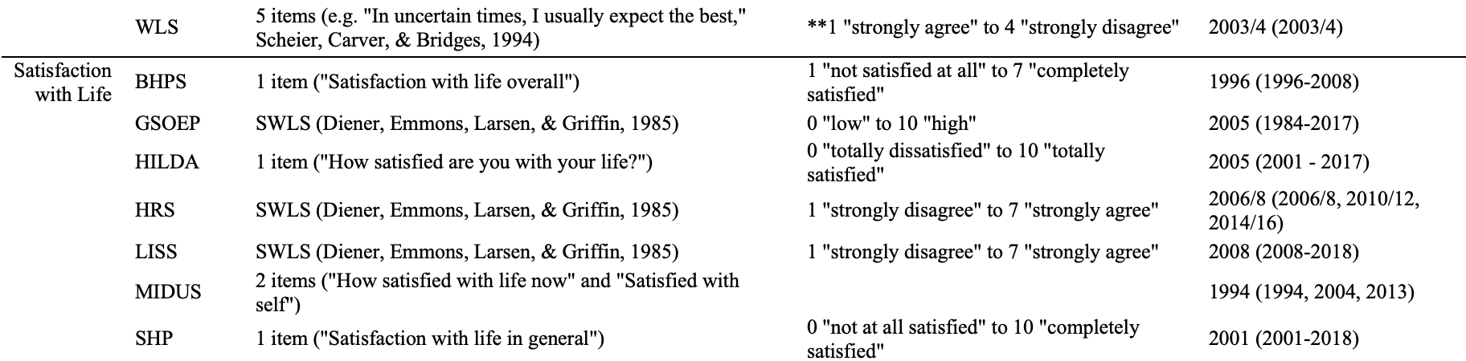

Slide 34
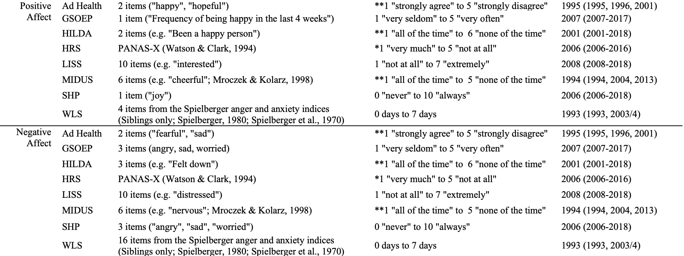

Slide 35
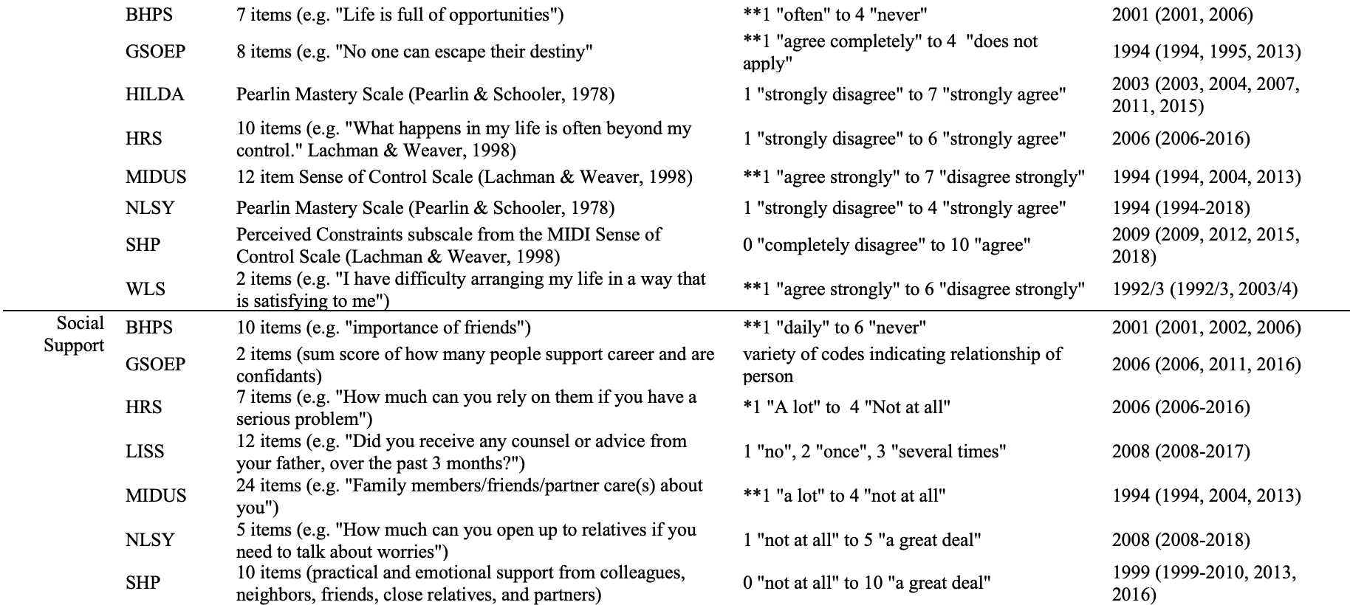

Slide 36
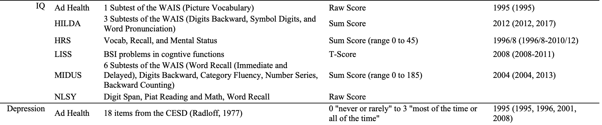
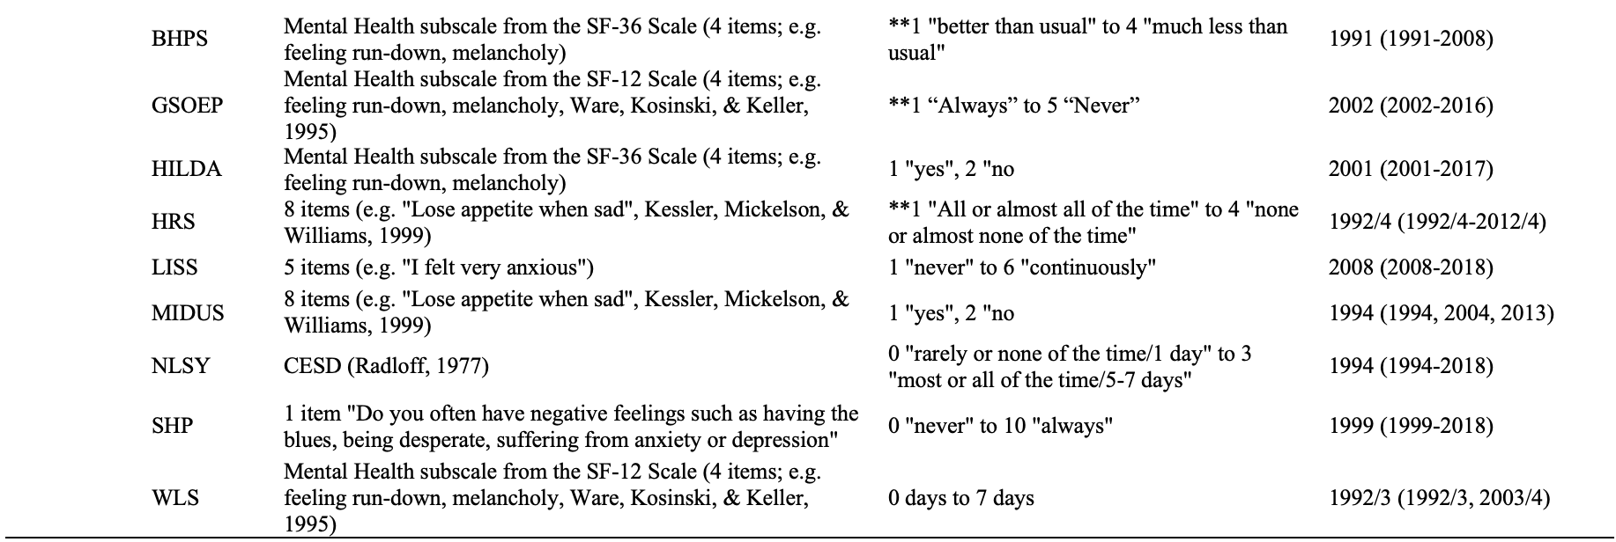

Slide 37

No Event
Event
Propensity Score Matching
(Thoemmes & Kim, 2011)
Notes:
But I didn’t, so I’m stuck looking for an alternative solution.
Technique called propensity score matching. Essentially take a bunch of predictors and use them to predict an outcome. Then use these predictions (so-called propensity scores for each person) and start matching people with the same propensities who did and didn’t experience events.

Slide 38
No Event
Event
PS = .2
(Thoemmes & Kim, 2011)

Slide 39
No Event
Event
PS = .2
PS = .6
(Thoemmes & Kim, 2011)

Slide 40
No Event
Event
PS = .2
PS = .6
PS = .9
(Thoemmes & Kim, 2011)

Slide 41
No Event
Event
PS = .2
PS = .6
PS = .9
PS = .3
(Thoemmes & Kim, 2011)

Slide 42
No Event
Event
PS = 1.2
PS = .6
PS = .9
PS = .4
PS = .3
PS = .7
PS = .6
PS = 1.0
PS = .1
PS = .9
(Thoemmes & Kim, 2011)
Notes:
Note that not everyone may have a match. Propensity scores don’t tend to be equal across groups. People who can’t be matched are left out.

Slide 43
Propensity Score Matching
Year of Birth | Physical Functioning | Unemployment Benefit
Gender | Life Satisfaction | Number of Siblings
Household ID | Satisfaction with Family | Married
Father Alive | Satisfaction with Income | Number of Children
Mother Alive | Satisfaction with School | Employment
Race | Neighborhood Quality | Height (in meters)
Ethnicity | Healthcare | Weight (in kg)
Gross Wages | Urban/Rural | Education
Welfare | Disability | Exercise
Household size | Father Education | Drinks Alcohol
Self-Rated Physical Health | Mother Education | Does Drugs
Body Mass Index (BMI) | Mother Age at Birth | Smokes
Loneliness | Doctor Visits | Physical Activity

Slide 44
Specification Curve Analysis
All possible specifications
Simonsohn, Simmons & Nelson, 2015

Slide 45
Specification Curve Analysis
Valid and non-redundant specifications
All possible specifications
Simonsohn, Simmons & Nelson, 2015

Slide 46
Specification Curve Analysis
Researcher # 1
Valid and non-redundant specifications
All possible specifications
Simonsohn, Simmons & Nelson, 2015

Slide 47
Specification Curve Analysis
Researcher # 3
Researcher # 4
Researcher # 1
Researcher # 2
Valid and non-redundant specifications
All possible specifications
Simonsohn, Simmons & Nelson, 2015

Slide 48
Specification Curve Analysis
Researcher # 3
Researcher # 4
Researcher # 1
Researcher # 2
Valid and non-redundant specifications
All possible specifications
Simonsohn, Simmons & Nelson, 2015

Slide 49
Specification Curve Analysis
Researcher # 3
Researcher # 4
Researcher # 1
Researcher # 2
Valid and non-redundant specifications
All possible specifications
Simonsohn, Simmons & Nelson, 2015

Slide 50
Specification Curve Analysis
Age
Gender
Health
SES
1 Covariate
2 Covariates
3 Covariates
4 Covariates
1. Age
5. Age + Gender
11. Age + Gender + Health
15. Age + Gender + Health + SES
2. Gender
6. Age + Health
12. Age + Gender + SES
0 Covariates
3. Health
7. Age + SES
13. Age + SES + Health
16.
4. SES
8. Gender + Health
14. Gender + Health + SES
9. Gender + SES
Total Specifications = 2^{# of terms}
10. Health + SES

Slide 51
7. Age + SES
12. Age + Gender + SES
14. Gender + Health + SES
8. Gender + Health
15. Age + Gender + Health + SES
5. Age + Gender
9. Gender + SES
6. Age + Health
10. Health + SES
1. Age
11. Age + Gender + Health
16.
2. Gender
3. Health
4. SES
13. Age + SES + Health

Slide 52
But does this pattern differ from chance?
7. Age + SES
12. Age + Gender + SES
14. Gender + Health + SES
8. Gender + Health
15. Age + Gender + Health + SES
5. Age + Gender
9. Gender + SES
6. Age + Health
10. Health + SES
1. Age
11. Age + Gender + Health
16.
2. Gender
3. Health
4. SES
13. Age + SES + Health

Slide 53
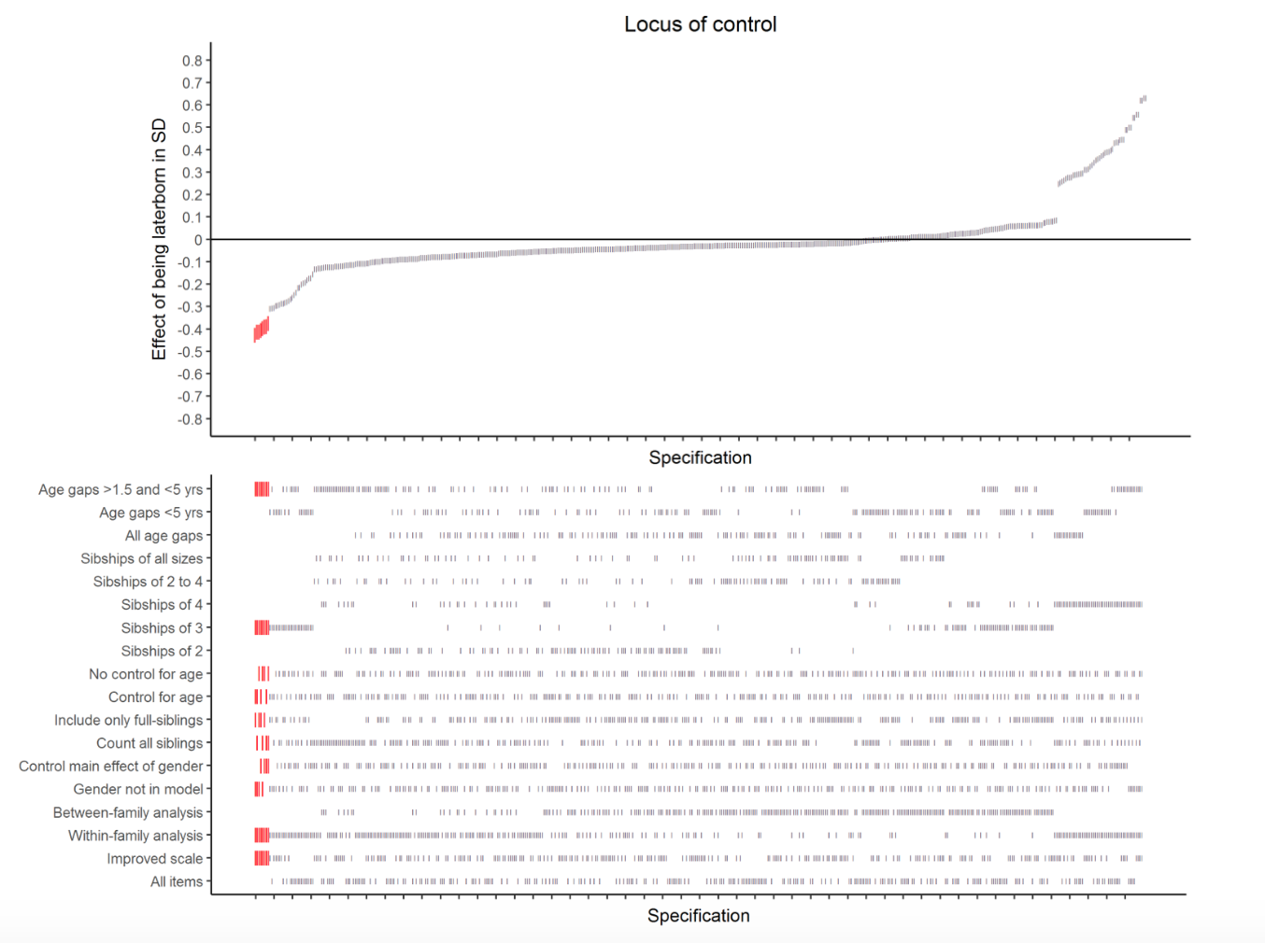
Criterion:
Magnitude
Direction
Significance
From Rohrer et al., 2017
Notes:
From the figure, it seems immediately clear that the association between the two is not robust. Despite this, by examining the specification curve in the top part of the figure and the patterns of covariates and operationalizations in the lower part of the figure, which have consequences for the presence, direction, and magnitude of the association becomes clear. For example, looking at the left side of the figure, the only specifications with significant effects, all of which were negative, were for siblingships of three in which the age gaps were between 1.5 and 5 years and that used within-family analysis. Examining the right side, in contrast, it becomes clear that the only positive effects were for siblingships of four that used within-family analysis. Indeed, there is clear cusp at the point in the specification curve when within-family analysis was used with siblingships of four. Thus, specification curve is a useful tool for both determining robustness as well as covariates that are consequential to robustness.

Slide 54
Criterion:
Magnitude
Direction
Significance
Siblingships of 3
Within-Family Analyses
Moderate age gaps
But does this pattern differ from chance?
Siblingships of 4
Within-Family Analyses
Regardless of age gap
From Rohrer et al., 2017
Notes:
From the figure, it seems immediately clear that the association between the two is not robust. Despite this, by examining the specification curve in the top part of the figure and the patterns of covariates and operationalizations in the lower part of the figure, which have consequences for the presence, direction, and magnitude of the association becomes clear. For example, looking at the left side of the figure, the only specifications with significant effects, all of which were negative, were for siblingships of three in which the age gaps were between 1.5 and 5 years and that used within-family analysis. Examining the right side, in contrast, it becomes clear that the only positive effects were for siblingships of four that used within-family analysis. Indeed, there is clear cusp at the point in the specification curve when within-family analysis was used with siblingships of four. Thus, specification curve is a useful tool for both determining robustness as well as covariates that are consequential to robustness.

Slide 55
1. Age
2. Gender
3. Health
4. SES
7. Age + SES
5. Age + Gender
8. Gender + Health
6. Age + Health
9. Gender + SES
10. Health + SES
11. Age + Gender + Health
But does this pattern differ from chance?
12. Age + Gender + SES
13. Age + SES + Health
14. Gender + Health + SES
15. Age + Gender + Health + SES
16.

Slide 56
Specification Curve Analysis
ID | Personality | Outcome | Age | Gender | Health | SES
1 | 9 | 1 | 42 | 0 | 3 | 0
2 | 7 | 0 | 26 | 0 | 3 | 1
3 | 4 | 1 | 57 | 1 | 4 | 1
4 | 2 | 1 | 40 | 1 | 2 | 2
5 | 5 | 1 | 36 | 0 | 1 | 1
6 | 6 | 0 | 44 | 1 | 4 | 1
7 | 8 | 0 | 60 | 1 | 5 | 0
8 | 9 | 0 | 21 | 0 | 2 | 0
9 | 9 | 0 | 35 | 0 | 3 | 1
10 | 1 | 1 | 52 | 1 | 3 | 1
Simonsohn, Simmons & Nelson, 2015

Slide 57
Specification Curve Analysis
ID | Personality | Outcome | Age | Gender | Health | SES
1 | 1 | 1 | 42 | 0 | 3 | 0
2 | 9 | 0 | 26 | 0 | 3 | 1
3 | 6 | 1 | 57 | 1 | 4 | 1
4 | 2 | 1 | 40 | 1 | 2 | 2
5 | 3 | 1 | 36 | 0 | 1 | 1
6 | 4 | 0 | 44 | 1 | 4 | 1
7 | 8 | 0 | 60 | 1 | 5 | 0
8 | 4 | 0 | 21 | 0 | 2 | 0
9 | 3 | 0 | 35 | 0 | 3 | 1
10 | 0 | 1 | 52 | 1 | 3 | 1
x 500 permutations
Simonsohn, Simmons & Nelson, 2015

Slide 58
7. Age + SES
12. Age + Gender + SES
14. Gender + Health + SES
8. Gender + Health
15. Age + Gender + Health + SES
5. Age + Gender
9. Gender + SES
6. Age + Health
10. Health + SES
1. Age
11. Age + Gender + Health
16.
2. Gender
3. Health
4. SES
13. Age + SES + Health

Slide 59
Specification Curve Analysis
(1) the median overall point estimate within each specification curve
(2) the number of specifications that are of the dominant sign
(3) the number of specifications with the dominant sign that are also significant
Simonsohn, Simmons & Nelson, 2015

Slide 60
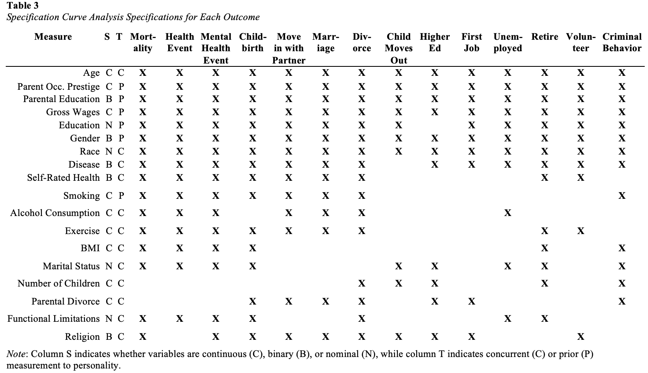
Specification Curve Analysis

Slide 61
14 Predictors | 7 Moderators | 14 Outcomes | 10 Studies
Propensity Score Matching
Multiple Imputation of matching variables.
Propensity score matching (separate for each predictor, outcome, study, and moderator)
Multilevel Bayesian Logistic Regression of matched and unmatched samples

Slide 62
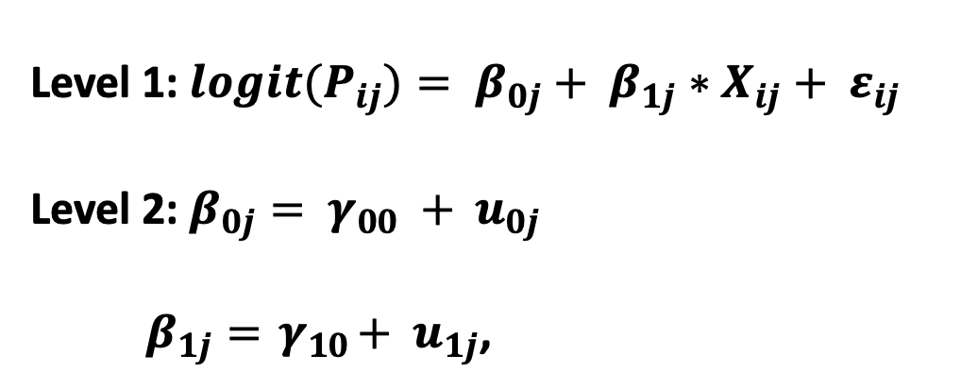
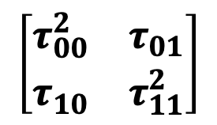
Propensity Score Matching
Level 1: ${logit(P}_{ij})= β_{0j}+ β_{1j}∗X_{ij}+ ε_{ij}$
Level 2: $β_{0j}= γ_{00} + u_{0j}$
$β_{1j}={ γ}_{10}+ { u}_{1j}$,
Dataset
Wisconsin Longitudinal Study (WLS)
German Socioeconomic Panel (GSOEP)
Longitudinal Internet Studies for the Social Sciences (LISS)
National Longitudinal Study of Youth (NLSY)
Household, Income, and Labor Dynamics in Australia (HILDA)
Midlife in the US Study (MIDUS)
British House Panel Study (BHPS)
Adolescent to Adult Health (Ad Health)
Health and Retirement Study (HRS)
Swiss Household Panel Study (SHP)
$$\left[\begin{matrix}τ_{00}^{2} & τ_{01} \\ τ_{10} & τ_{11}^{2}\end{matrix}\right]$$
Study-specific personality-outcome associations
Average personality-outcome association
Study-specific deviations
Variance in personality-outcome associations

Slide 63
Propensity Score Matching
Year of Birth | Physical Functioning | Unemployment Benefit
Gender | Life Satisfaction | Number of Siblings
Household ID | Satisfaction with Family | Married
Father Alive | Satisfaction with Income | Number of Children
Mother Alive | Satisfaction with School | Employment
Race | Neighborhood Quality | Height (in meters)
Ethnicity | Healthcare | Weight (in kg)
Gross Wages | Urban/Rural | Education
Welfare | Disability | Exercise
Household size | Father Education | Drinks Alcohol
Self-Rated Physical Health | Mother Education | Does Drugs
Body Mass Index (BMI) | Mother Age at Birth | Smokes
Loneliness | Doctor Visits | Physical Activity

Slide 64
14 Predictors | 7 Moderators | 14 Outcomes | 10 Studies
Propensity Score Matching
Specification Curve Analysis
Multiple Imputation of matching variables.
Propensity score matching (separate for each predictor, outcome, study, and moderator)
Multilevel Bayesian Logistic Regression of matched and unmatched samples
Identification of theoretically plausible specifications for each outcome.
Multilevel Logistic Regression of all possible combinations of theoretically plausible specifications
Inferential Permutation-based test of whether the specification curve differs from the null of no effect

Slide 65
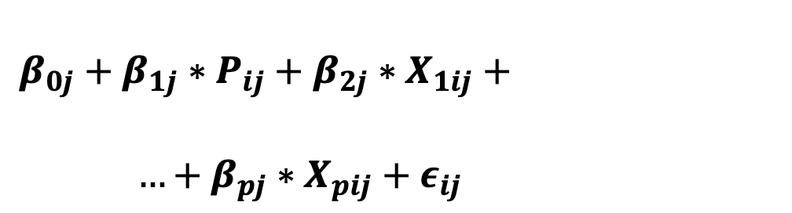
Specification Curve Analysis
$$β_{0j}+β_{1j}∗P_{ij}+β_{2j}∗X_{1ij}+$$
$…+β_{pj}∗X_{pij}+ε_{ij}$
Dataset
Wisconsin Longitudinal Study (WLS)
German Socioeconomic Panel (GSOEP)
Longitudinal Internet Studies for the Social Sciences (LISS)
National Longitudinal Study of Youth (NLSY)
Household, Income, and Labor Dynamics in Australia (HILDA)
Midlife in the US Study (MIDUS)
British House Panel Study (BHPS)
Adolescent to Adult Health (Ad Health)
Health and Retirement Study (HRS)
Swiss Household Panel Study (SHP)
Average personality-outcome association
Additional Covariates

Slide 66
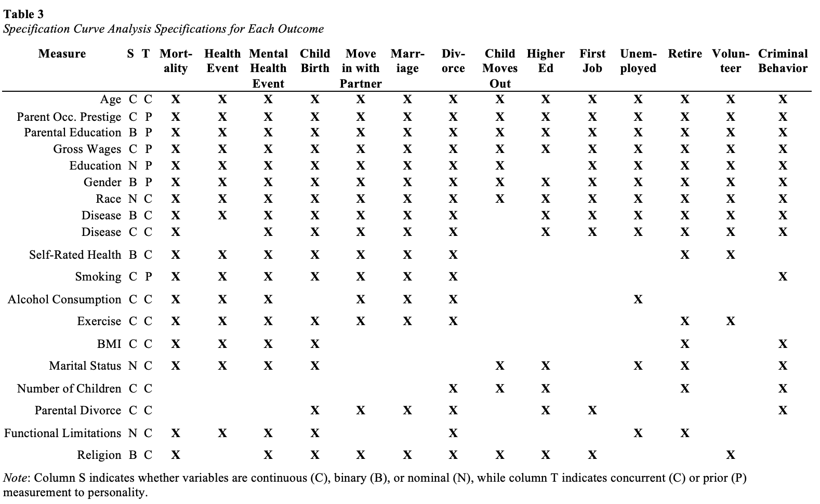
Specification Curve Analysis

Slide 67
Results
R Shiny Web Application: https://emoriebeck.shinyapps.io/selection
All Code & Results: https://github.com/emoriebeck/selection

Slide 68
Results
Propensity Score Matching
R Shiny Web Application: https://emoriebeck.shinyapps.io/selection
All Code & Results: https://github.com/emoriebeck/selection

Slide 69
PSM Balance | Unmoderated Prediction | Moderators of Prediction

Slide 70
PSM Balance | Unmoderated Prediction | Moderators of Prediction
emoriebeck.shinyapps.io/selection

Slide 71
PSM Balance | Unmoderated Prediction | Moderators of Prediction
emoriebeck.shinyapps.io/selection
https://github.com/emoriebeck/selection/tree/master/results/psm/bal_plots

Slide 72
Propensity Score Matching
Level 1: ${logit(P}_{ij})= β_{0j}+ β_{1j}∗X_{ij}+ ε_{ij}$
Level 2: $β_{0j}= γ_{00} + u_{0j}$
$β_{1j}={ γ}_{10}+ { u}_{1j}$,
Dataset
Wisconsin Longitudinal Study (WLS)
German Socioeconomic Panel (GSOEP)
Longitudinal Internet Studies for the Social Sciences (LISS)
National Longitudinal Study of Youth (NLSY)
Household, Income, and Labor Dynamics in Australia (HILDA)
Midlife in the US Study (MIDUS)
British House Panel Study (BHPS)
Adolescent to Adult Health (Ad Health)
Health and Retirement Study (HRS)
Swiss Household Panel Study (SHP)
$$\left[\begin{matrix}τ_{00}^{2} & τ_{01} \\ τ_{10} & τ_{11}^{2}\end{matrix}\right]$$
Study-specific personality-outcome associations
Average personality-outcome association
Study-specific deviations
Variance in personality-outcome associations

Slide 73
PSM Balance | Unmoderated Prediction | Moderators of Prediction
Mega-Analytic Estimates ($γ_{10}$): 32.65% robust after matching
https://github.com/emoriebeck/selection/tree/master/results/psm/matched/tables

Slide 74
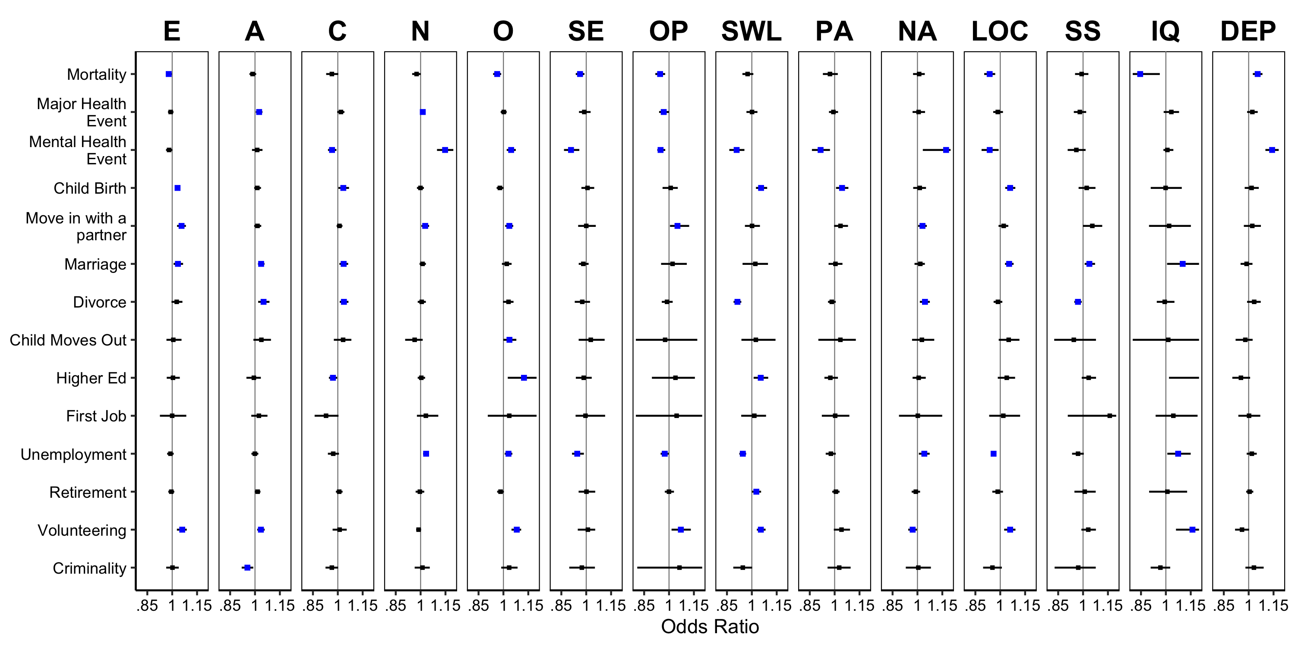
PSM Balance | Unmoderated Prediction | Moderators of Prediction
Mega-Analytic Estimates ($γ_{10}$): 32.65% robust after matching
Health
Social
Work/Edu
Civic

Slide 75
PSM Balance | Unmoderated Prediction | Moderators of Prediction
Mega-Analytic Estimates ($γ_{10}$): 32.65% robust after matching
Health
Social
Work/Edu
Civic

Slide 76
PSM Balance | Unmoderated Prediction | Moderators of Prediction
Study-Specific Estimates ($β_{1J}$)
https://github.com/emoriebeck/selection/tree/master/results/psm/matched/tables

Slide 77
PSM Balance | Unmoderated Prediction | Moderators of Prediction
Study-Specific Estimates ($β_{1J}$)
https://github.com/emoriebeck/selection/tree/master/results/psm/matched/tables

Slide 78
PSM Balance | Unmoderated Prediction | Moderators of Prediction
Study-Specific Estimates ($β_{1J}$)
https://github.com/emoriebeck/selection/tree/master/results/psm/matched/tables

Slide 79
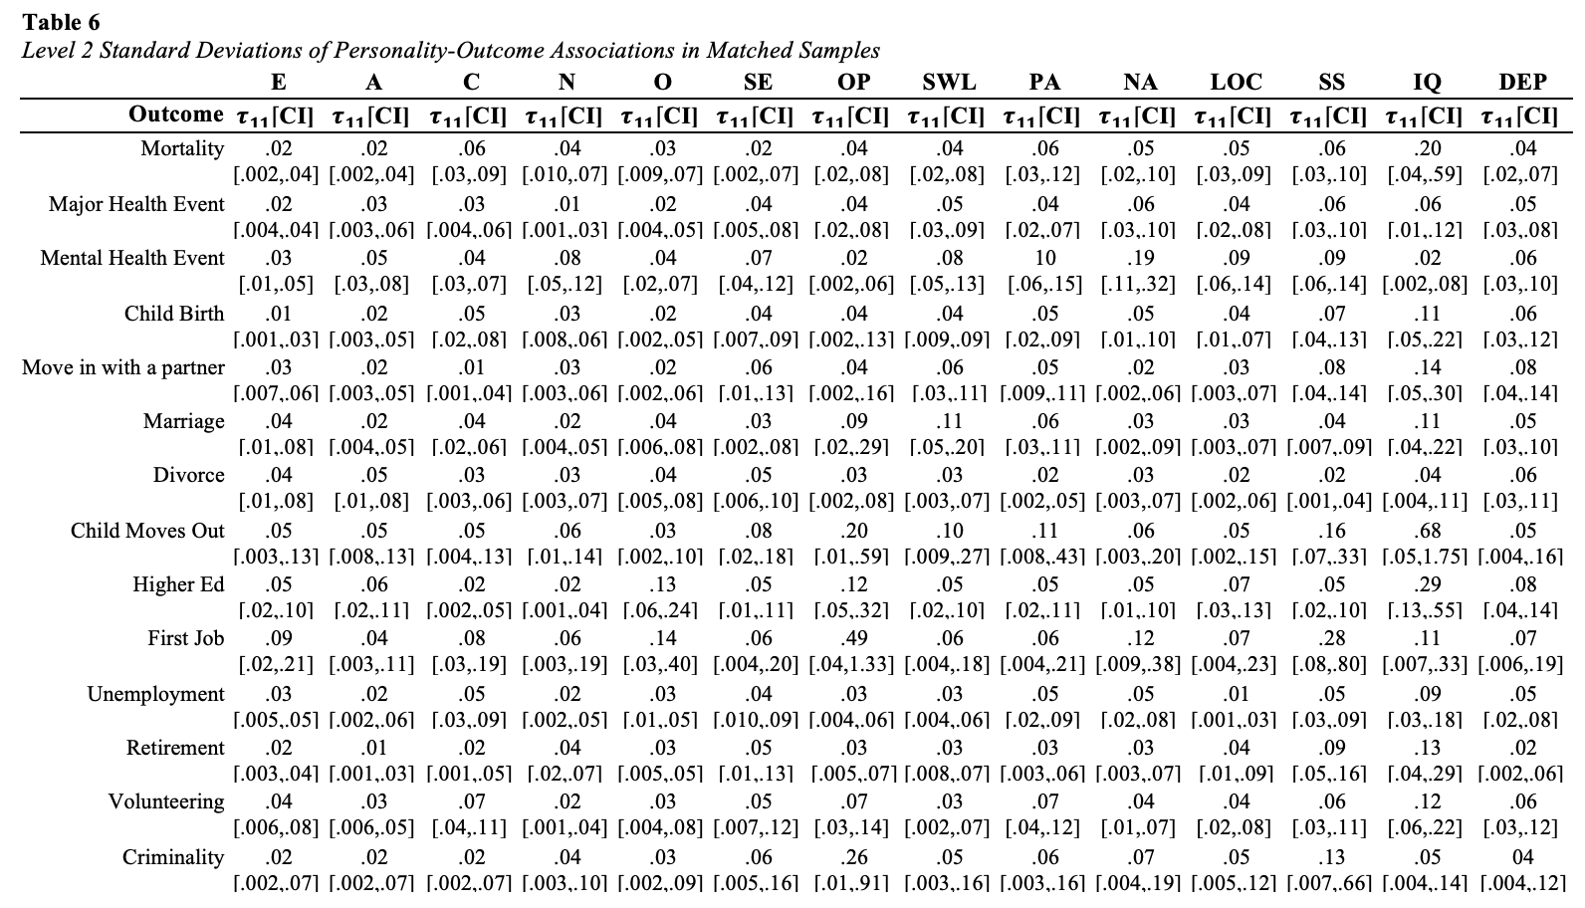
PSM Balance | Unmoderated Prediction | Moderators of Prediction
Health
Social
Work/Edu
Civic

Slide 80
PSM Balance | Unmoderated Prediction | Moderators of Prediction
…too many results to parse through in a short amount of time
Top/Bottom Moderators
Most/Least
Moderated Traits
Most/Least
Moderated Outcomes

Slide 81
PSM Balance | Unmoderated Prediction | Moderators of Prediction
…too many results to parse through in a short amount of time
Top/Bottom Moderators
Most/Least
Moderated Traits
Most/Least
Moderated Outcomes
6.70% significant overall
Parental Education: 11.20%*
Age: 10.20%
Gender: 9.80%
…
Race: 3.57%**
Reliability: 1.02%
14/14 moderated
Social Support: 12.50%
Conscientiousness, Openness: 10.70%
…
IQ: 3.57%
Optimism: 2.68%
11/14 moderated
Unemployment: 13.4%
Move in with a Partner: 10.7%
…
Education: 3.57%
Child Moves Out, First Job, Criminal Behavior: 0%
*high school or below versus either 2/4-year college, 8.16%; degree or beyond 4 years of college, 4.08%
**white versus Black, 3.06%; white versus other; .51%

Slide 82
Results
Specification Curve Analysis
R Shiny Web Application: https://emoriebeck.shinyapps.io/selection
All Code & Results: https://github.com/emoriebeck/selection

Slide 83
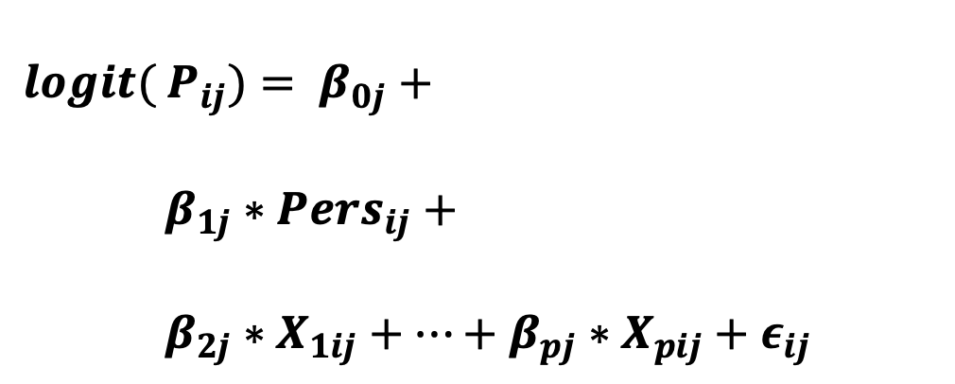
Specification Curve Analysis
$$logit( {P_{ij})= β}_{0j}+$$
$β_{1j}∗{Pers}_{ij}+$
$β_{2j}∗X_{1ij}+…+β_{pj}∗X_{pij}+ε_{ij}$
Dataset
Wisconsin Longitudinal Study (WLS)
German Socioeconomic Panel (GSOEP)
Longitudinal Internet Studies for the Social Sciences (LISS)
National Longitudinal Study of Youth (NLSY)
Household, Income, and Labor Dynamics in Australia (HILDA)
Midlife in the US Study (MIDUS)
British House Panel Study (BHPS)
Adolescent to Adult Health (Ad Health)
Health and Retirement Study (HRS)
Swiss Household Panel Study (SHP)
Average personality-outcome association
Additional Covariates

Slide 84
Inference Tests | Specification Curves | Key Variables
Inference Test Robustness
Very Robust | 3/3 < .0167 | 102/196 (52.04%)
Somewhat Robust | 2/3 < .0167 | 44/196 (22.44%)
Not Robust | 0-1/3 < .0167 | 50/196 (25.51%)

Slide 85
Inference Tests | Specification Curves | Key Variables
Inference Test Robustness
Very Robust | 3/3 < .0167 | 102/196 (52.04%)
Somewhat Robust | 2/3 < .0167 | 44/196 (22.44%)
Not Robust | 0-1/3 < .0167 | 50/196 (25.51%)

Slide 86
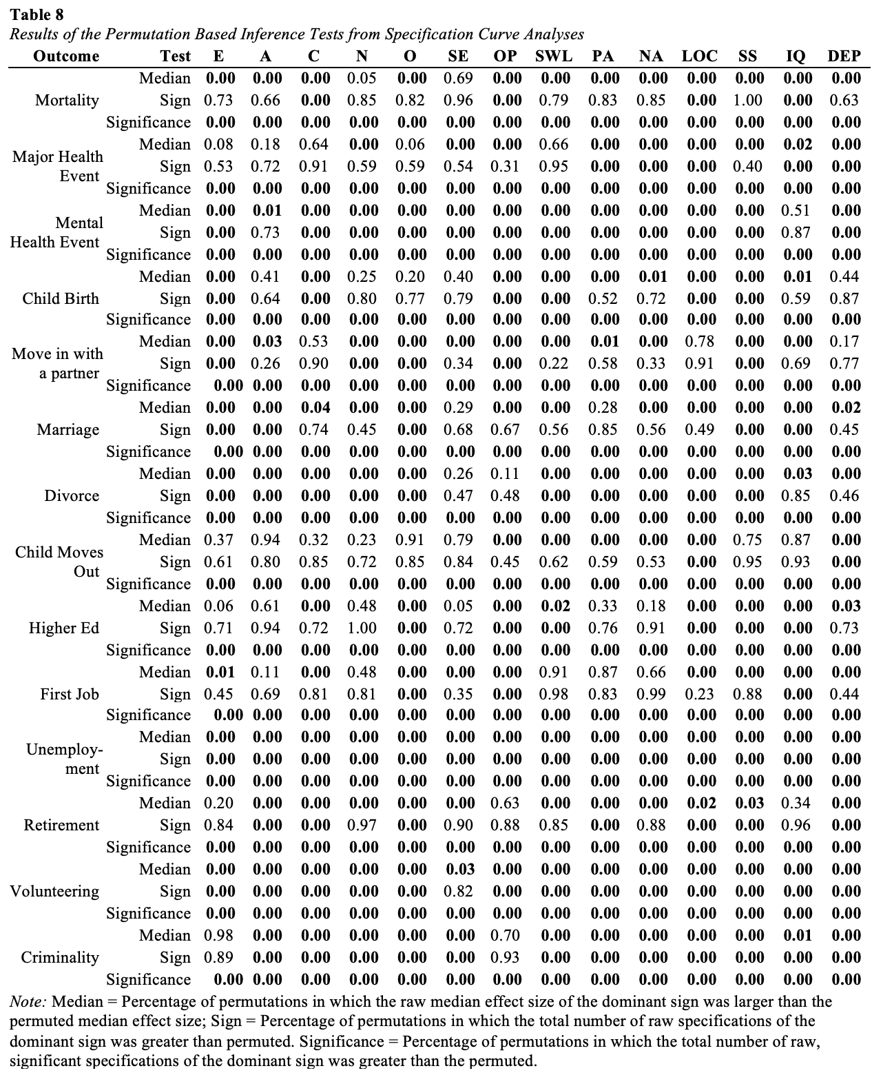
Inference Tests | Specification Curves | Key Variables
Inference Test Robustness
Health
Very Robust | 3/3 < .0167 | 102/196 (52.04%)
Somewhat Robust | 2/3 < .0167 | 44/196 (22.44%)
Not Robust | 0-1/3 < .0167 | 50/196 (25.51%)
Social
Work/Edu
Civic

Slide 87
Inference Tests | Specification Curves | Key Variables
Inference Test Robustness
Health
Very Robust | 3/3 < .0167 | 102/196 (52.04%)
Somewhat Robust | 2/3 < .0167 | 44/196 (22.44%)
Not Robust | 0-1/3 < .0167 | 50/196 (25.51%)
Social
Work/Edu
Civic

Slide 88
Inference Tests | Specification Curves | Key Variables
Observed Curve Robustness
Not Robust | 60/196 (30.61%)
Robust | 18/196 (9.18%)
Differential, No clear pattern | 16/196 (8.16%)
Differential, Clear pattern | 102/196 (52.04%)
R Shiny Web Application: https://emoriebeck.shinyapps.io/selection

Slide 89
Inference Tests | Specification Curves | Key Variables
Observed Curve Robustness
Not Robust | 60/196 (30.61%)
Robust | 18/196 (9.18%)
Differential, No clear pattern | 16/196 (8.16%)
Differential, Clear pattern | 102/196 (52.04%)
R Shiny Web Application: https://emoriebeck.shinyapps.io/selection

Slide 90
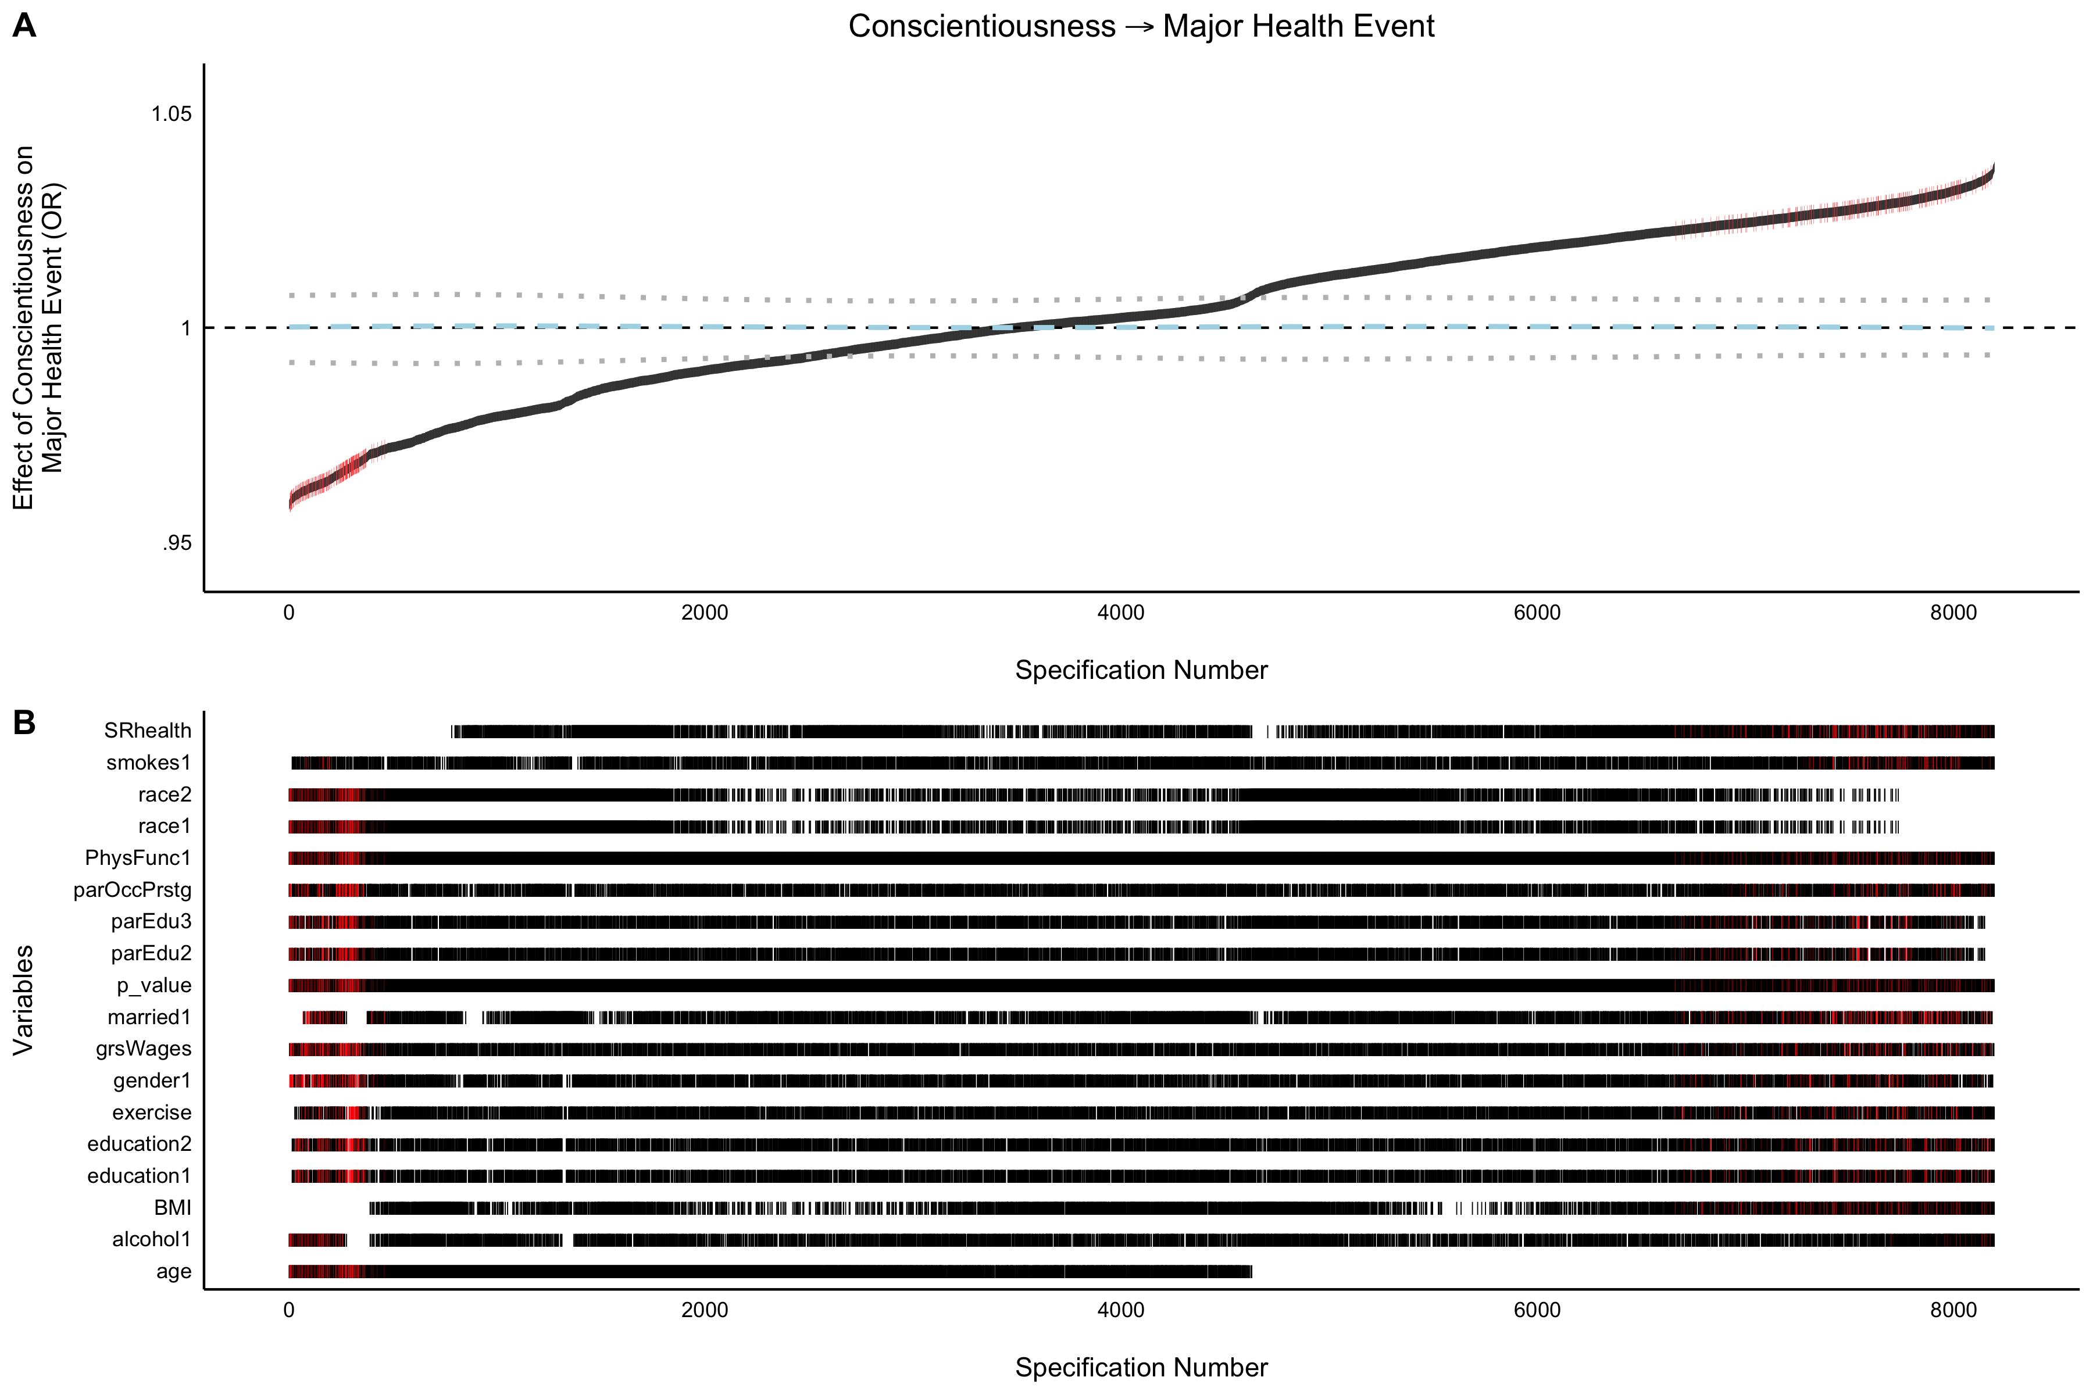
Inference Tests | Specification Curves | Key Variables
Not Robust | 60/196 (30.61%)

Slide 91
Inference Tests | Specification Curves | Key Variables
Not Robust | 60/196 (30.61%)
Self-rated health attenuates the relationship
Age impacts the direction of the relationship

Slide 92
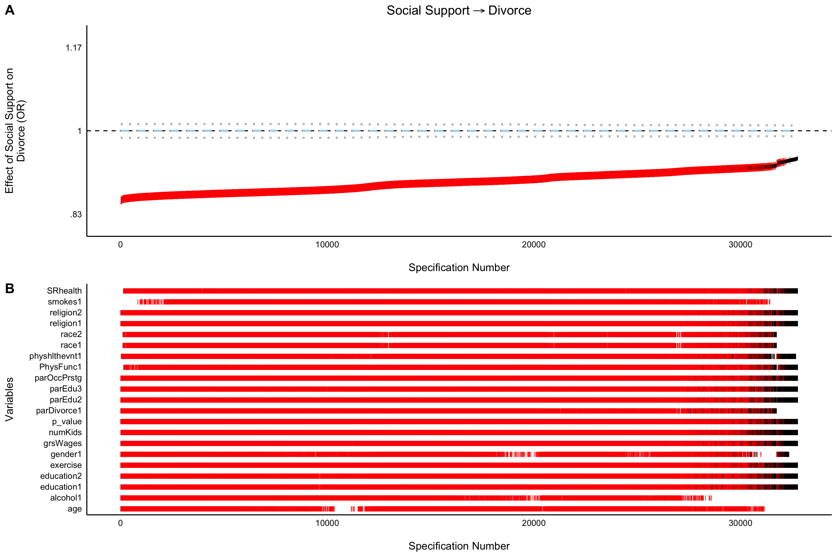
Inference Tests | Specification Curves | Key Variables
Robust | 18/196 (9.18%)
Not a lot of effect size change
Only specifications including age and alcohol are significant

Slide 93
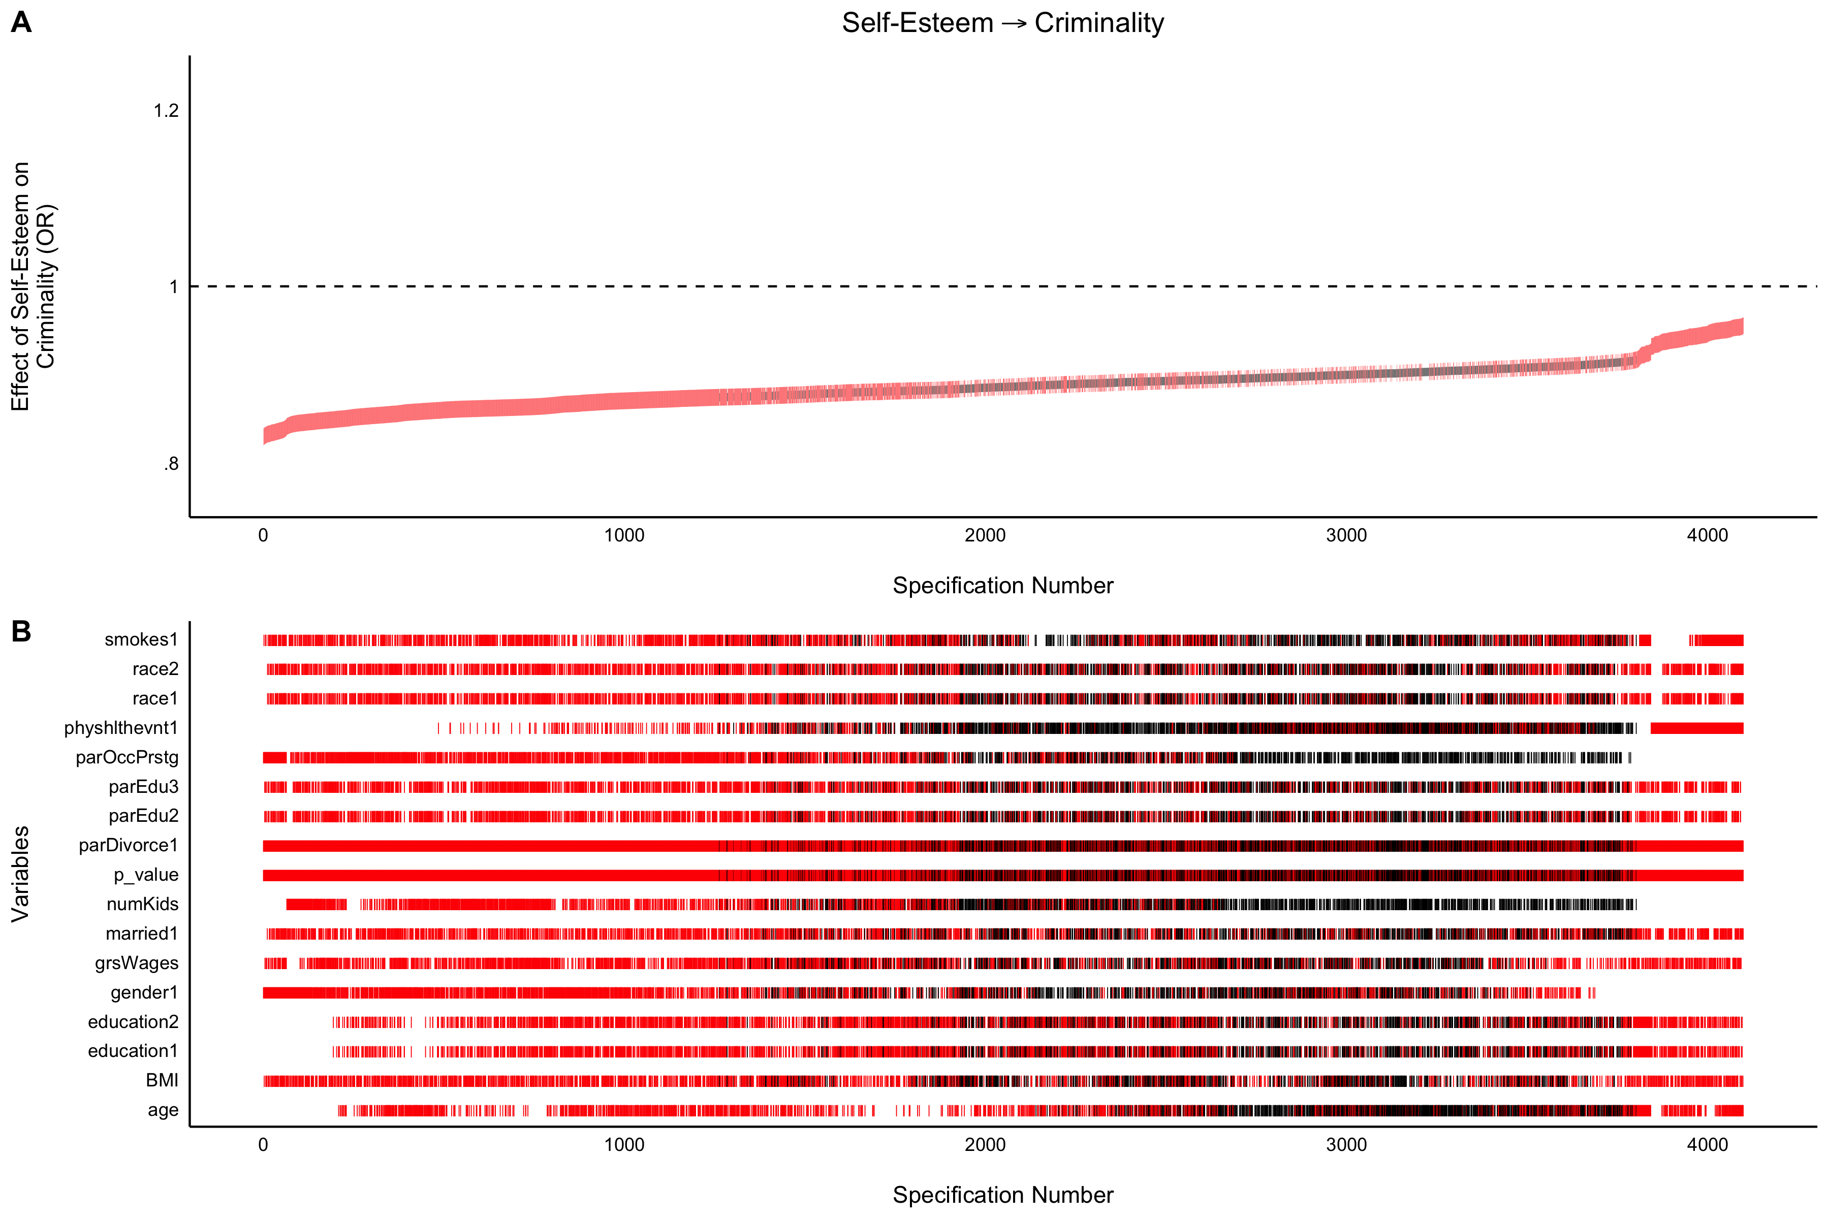
Inference Tests | Specification Curves | Key Variables
Differential, No clear pattern | 16/196 (8.16%)
Not a lot of effect size change

Slide 94
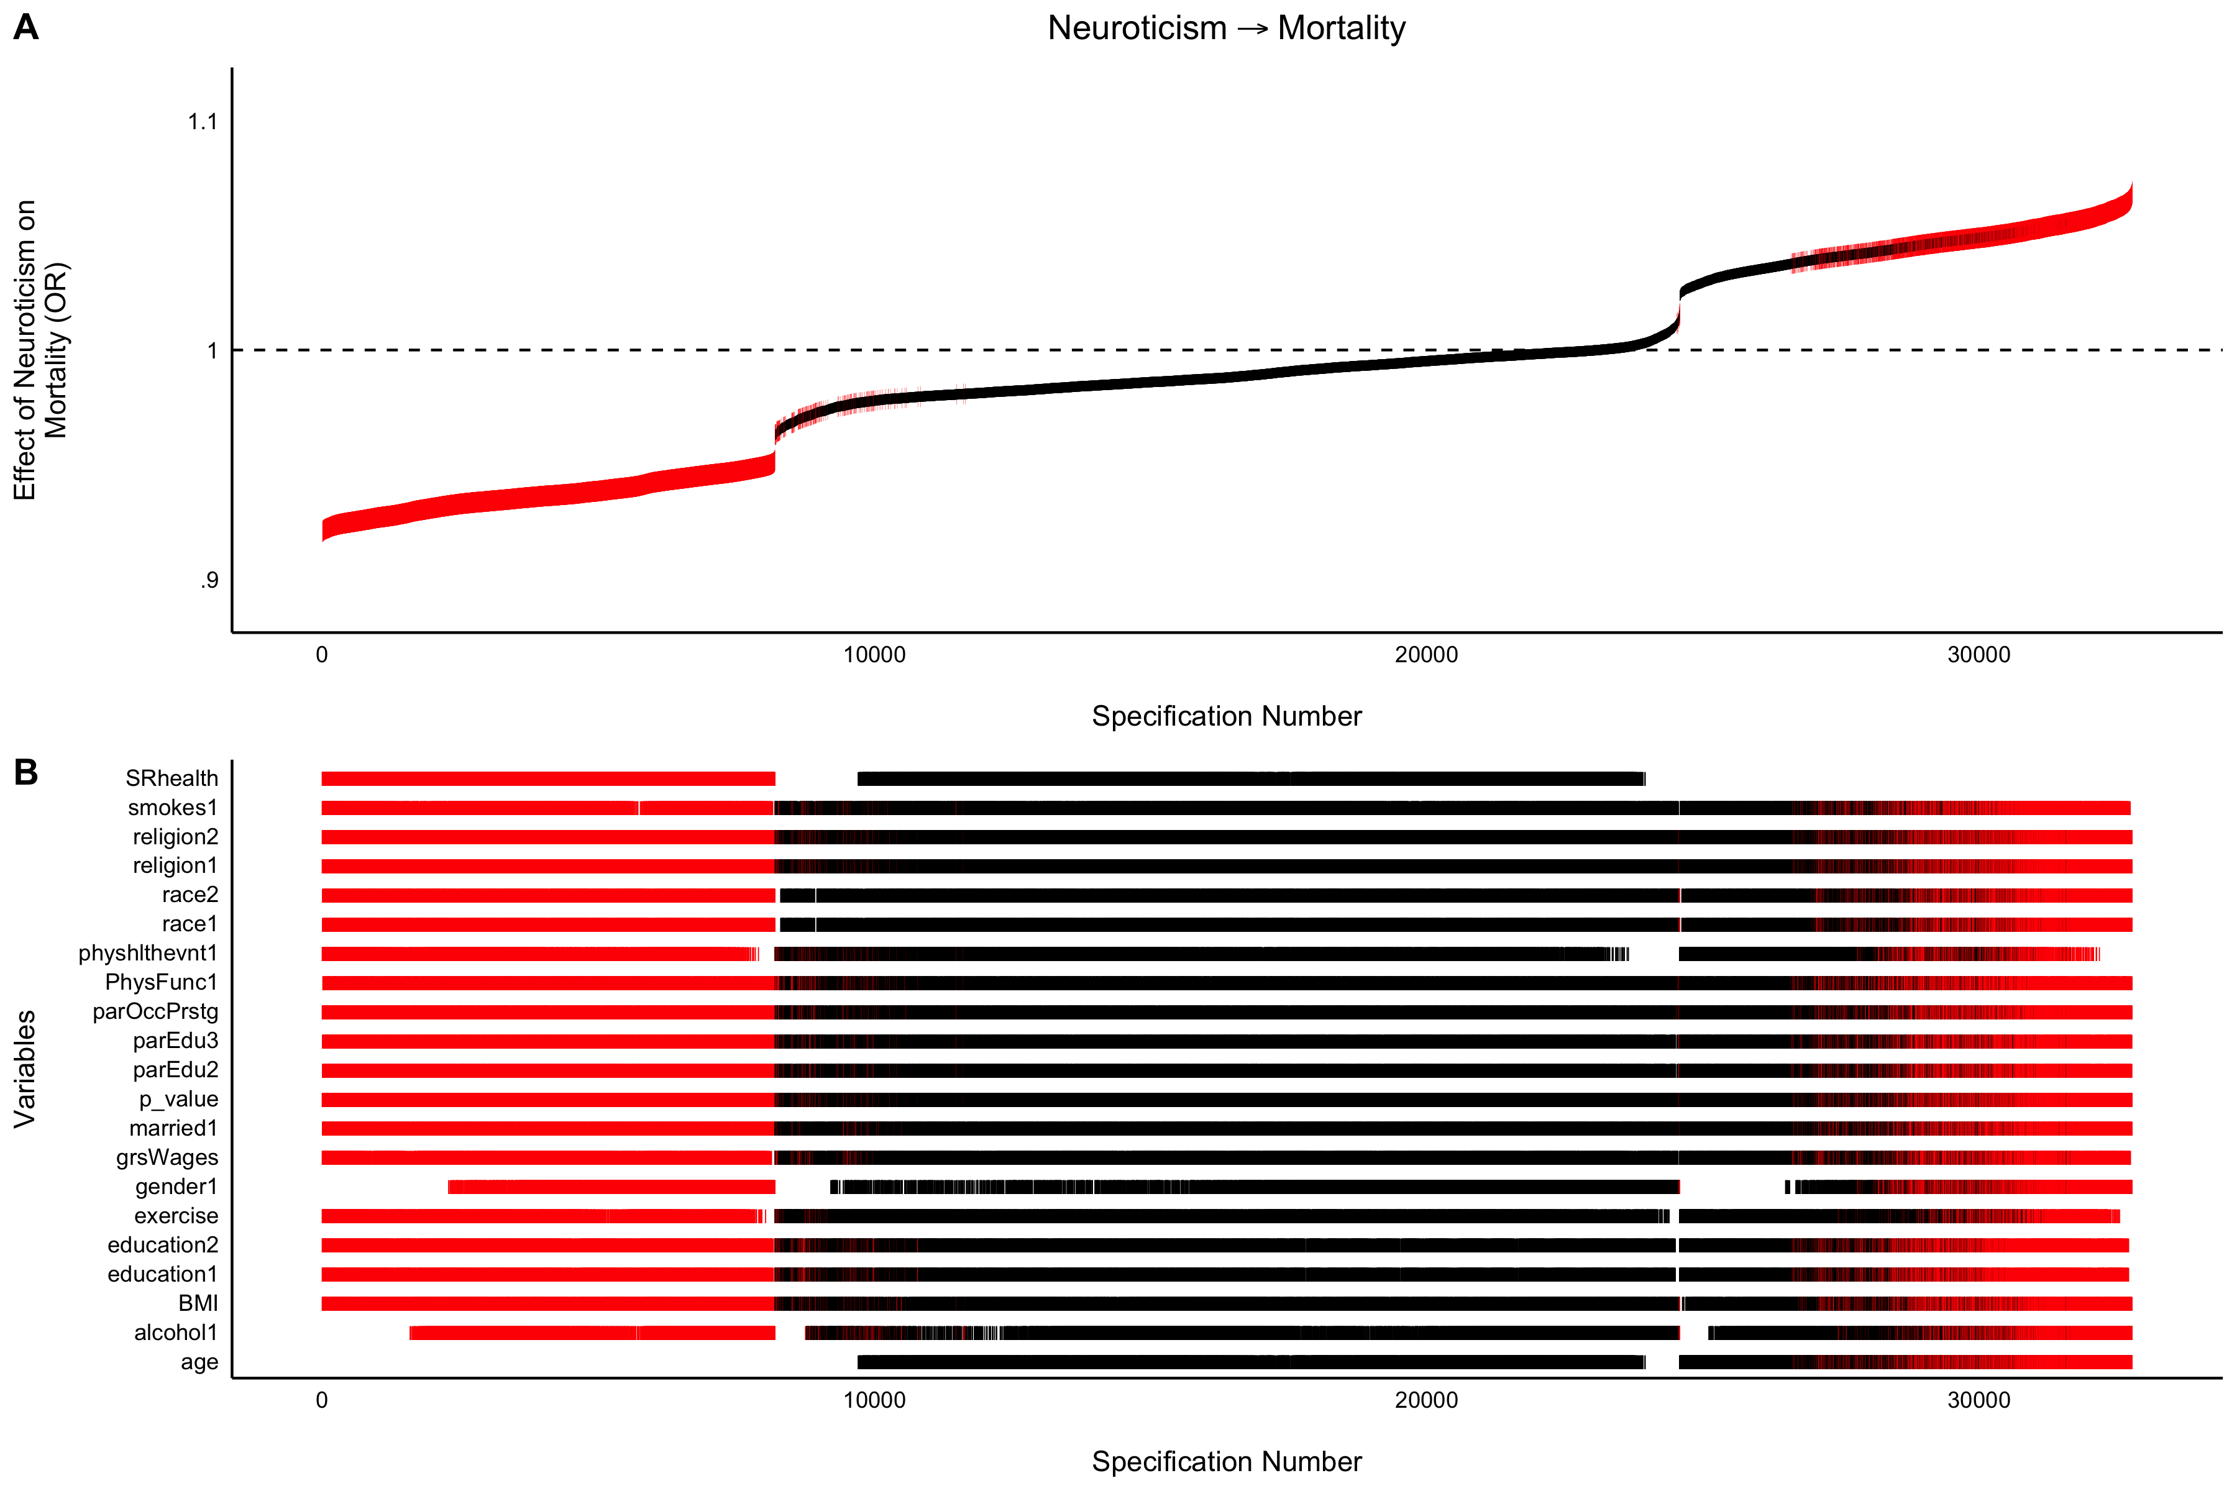
Inference Tests | Specification Curves | Key Variables
Differential, Clear pattern | 102/196 (52.04%)
Significant and negative with self-rated health but not age
Largely null when controlling for both
Somewhat Significant and positive with age but not self-rated health

Slide 95
Inference Tests | Specification Curves | Key Variables
Observed Curve Robustness
Not Robust | 60/196 (30.61%)
Robust | 18/196 (9.18%)
Differential, No clear pattern | 16/196 (8.16%)
Differential, Clear pattern | 102/196 (52.04%)
For all specification curve plots, a several sentence summary of each plot, and a list of key variables in each plot, see the Specification Curve Panel of the R Shiny Web Application:
R Shiny Web Application: https://emoriebeck.shinyapps.io/selection

Slide 96
Discussion

Slide 97
Summary | Key Variables | Future Directions
Personality prediction is quite robust.
32.65% of unmoderated associations robust after matching
Proportionally fewer moderators of personality-outcome associations (6.70%)
52.04% of associations very robust across specifications
61.22% of observed associations robust across all specifications

Slide 98
Summary | Key Variables | Future Directions

Slide 99
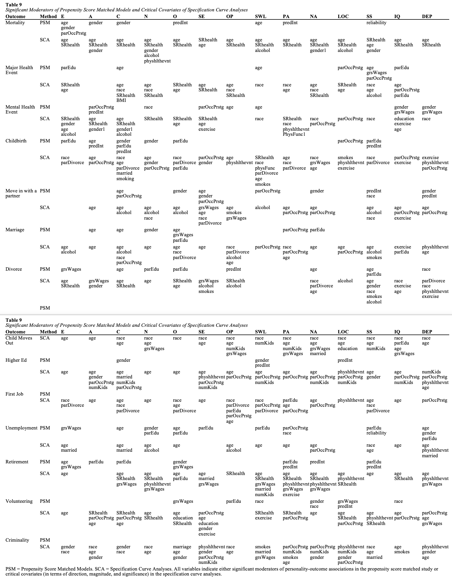
Summary | Key Variables | Future Directions
R Shiny Web Application: https://emoriebeck.shinyapps.io/selection
“Key Variables” Tab

Slide 100
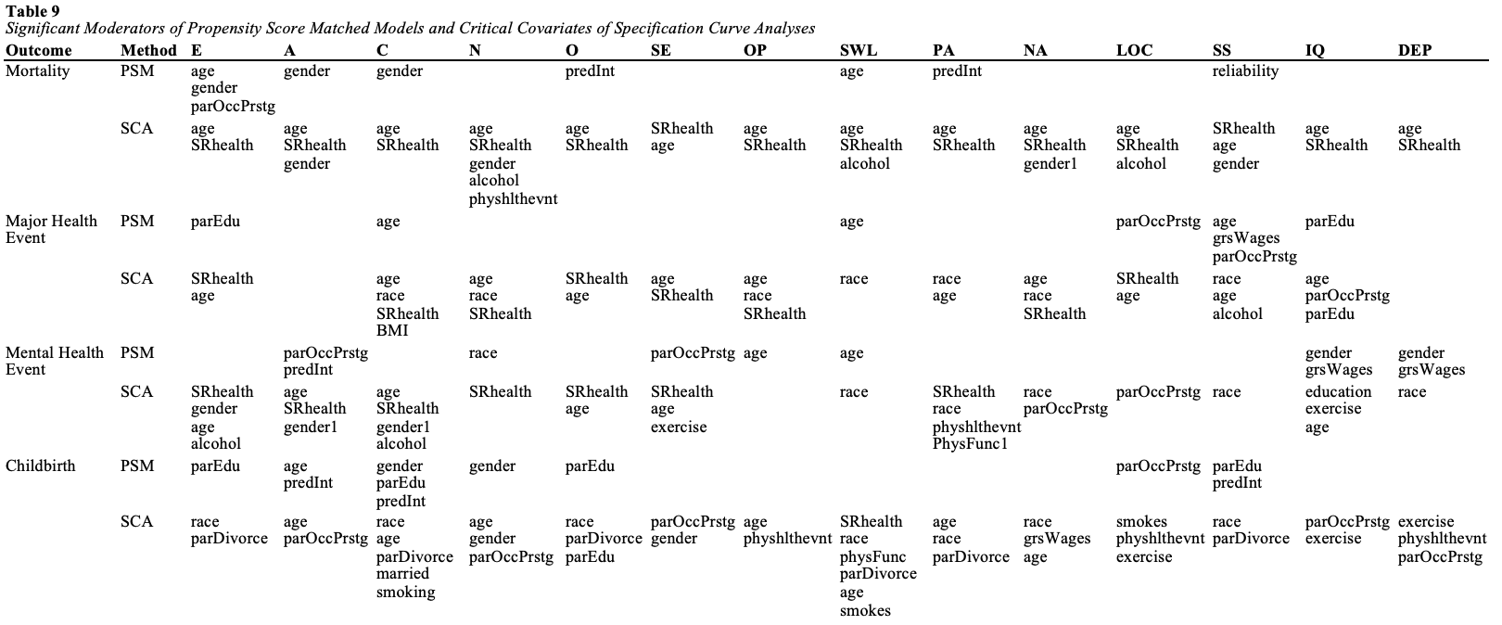
Summary | Key Variables | Future Directions
Health-Related Outcomes

Slide 101
Summary | Key Variables | Future Directions
Health-Related Outcomes

Slide 102
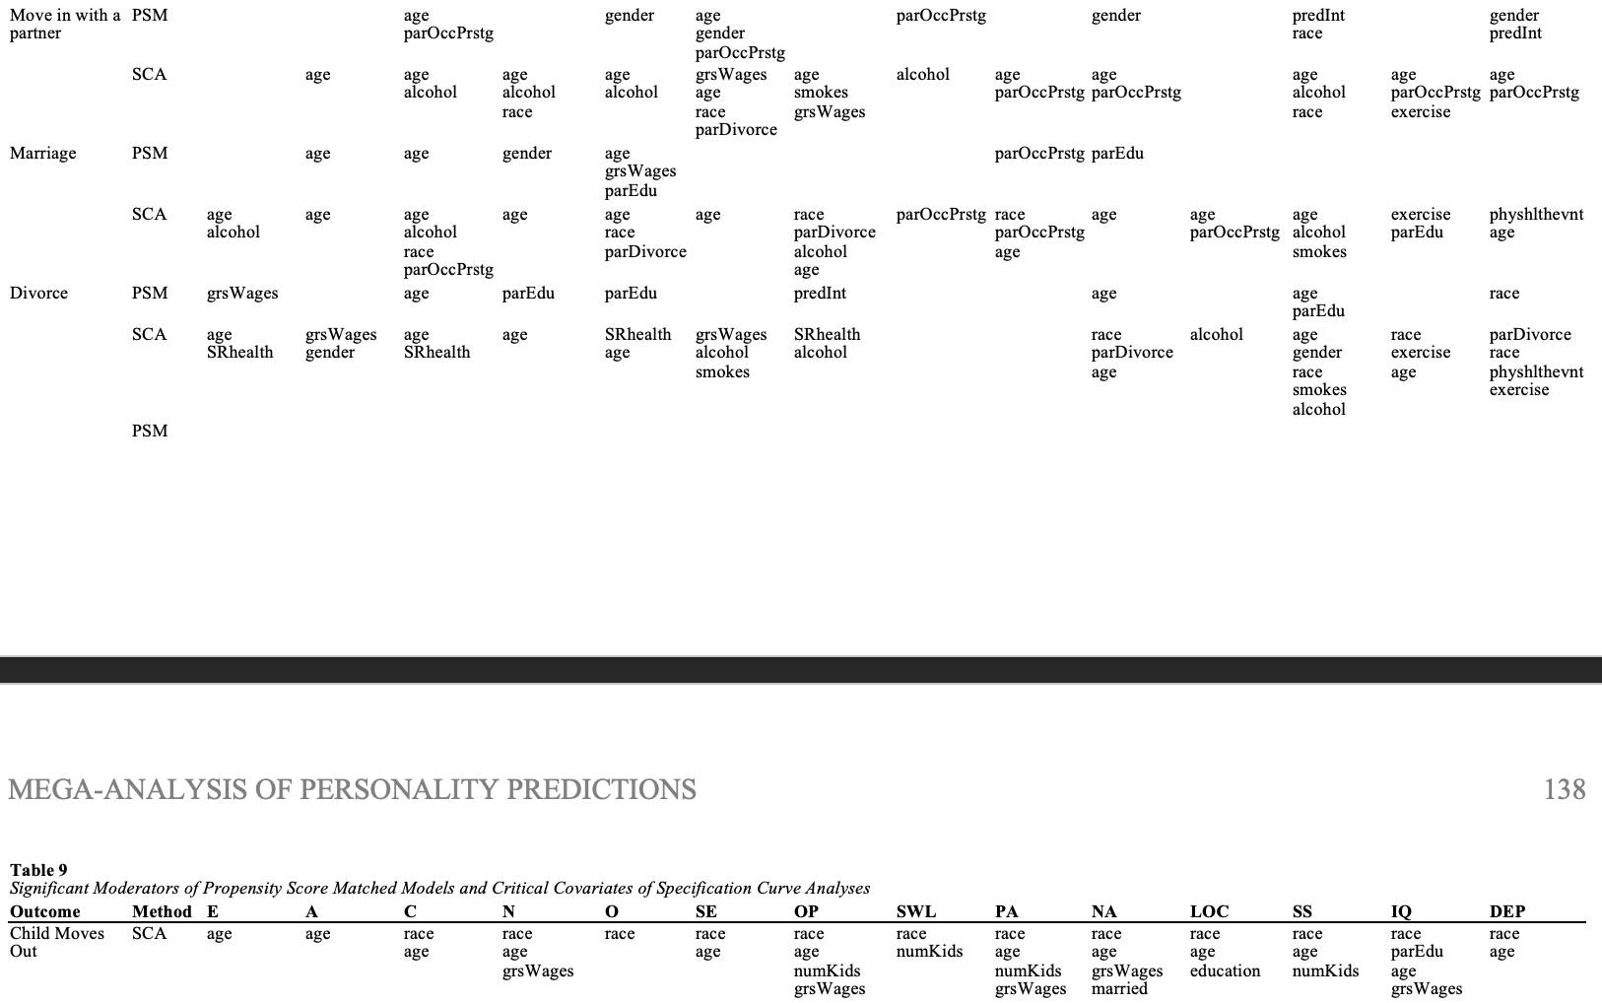
Summary | Key Variables | Future Directions
Social and Interpersonal Outcomes

Slide 103
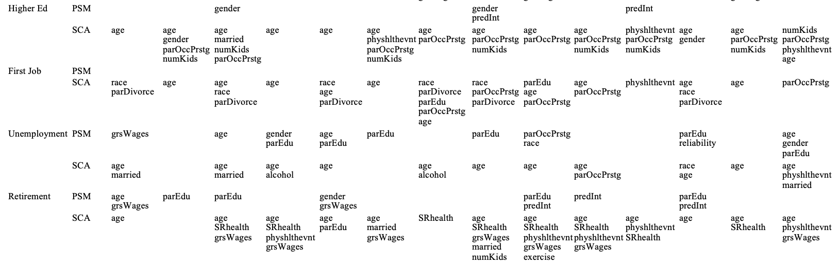
Summary | Key Variables | Future Directions
Work- and Education-Related Outcomes

Slide 104
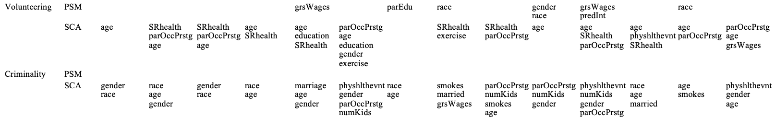
Summary | Key Variables | Future Directions
Civic / Societal Outcomes

Slide 105
Summary | Key Variables | Future Directions
Narrower outcomes (e.g., break health events down into specific causes)
The other half of reverse causality (i.e. socialization effects)
Coupling PSM and SCA with models to address more process-related questions

Slide 106
Personality prediction is quite robust.
Across:
Studies
Personality Characteristics
Outcomes
Moderators
Covariates
As well as:
Decades
Countries
Propensity score matching and specification curve analyses are powerful tools for pushing personality research forward

Slide 107
Acknowledgements
Dissertation Committee
Josh Jackson
Patrick Hill
Randy Larsen
Tammy English
Tom Oltmanns
David Condon
Data Sources
BHPS (and US)
GSOEP
HILDA
HRS
LISS
MIDUS
NLSY
SHP
WLS (G&S)
Analytic Tools
WUSTL Center for High Performance Computing
Funding Sources: National Institute on Aging Grant T32 AG00030-32; National Institute on Aging Grant 1R01AG067622

